Slide 1

Principles of Management
Unit 7
Change Management
N K BETCHOO

Slide 2
Managing Change
Management of change has become an issue of importance in organisations and managers must cope effectively with such a phenomenon so that their businesses can survive.
Management of change is only possible through people.
Employees of the organisation must cooperate with management so that change can take effective subtly without much upheaval.
Change then becomes an inevitable aspect of business.

Slide 3
Forces affecting Change
Forces for change External forces
Change takes places through forces from different instances. Below, the external and internal forces of change are outlined.
Political
Economical
Social
Technological

Slide 4
Forces affecting Change
Forces for change Internal forces
Change takes places through forces from different instances.
Company strategy
Equipment
Employee attitudes
Technology

Slide 5
The Change Process
The change process in the organizsation.
According to Lewin, successful change requires:
Unfreezing the status-quo
Changing into a new state
And refreezing the new change to make it permanent.

Slide 6
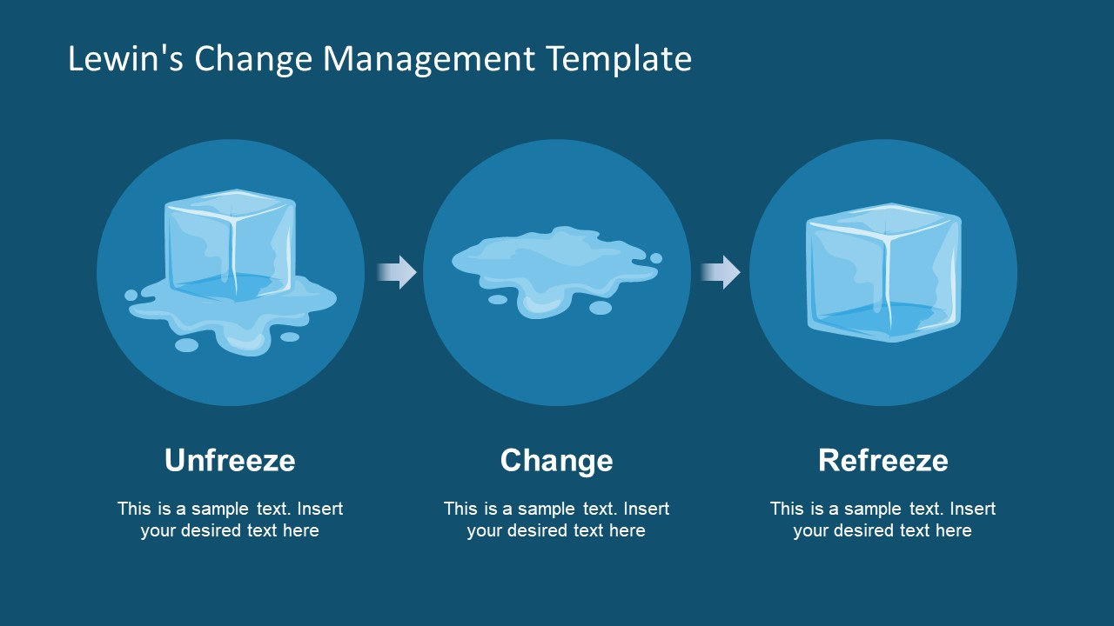
The Change Process

Slide 7
Why employees resist Change
Resistance to change
Individuals in the organisation will resist change because:
change can cause uncertainty to them for their future
they are concerned with the threat of loss of identity or recognition
they can believe that change is not in the organisation’s best interest.
they fear for the unknown

Slide 8
How to bring change to an organisation
Effective communication
Participate with employees
Negotiate change with employees: win-win
Co-opt for change
Facilitation and support

Slide 9
Benefits of change to an organisation
New work pattern
Better adaptation to competition
More responsive to external forces
Responding to future needs of the firm
Adopting the existing industry standards
A strategy for company survival

