Slide 1

Principles of Management
Unit 10
Leadership Theories
N K BETCHOO

Slide 2
Leadership Theories
Leaders are described as those people who are able to influence others and who possess managerial authority.
There should be some distinction between managers and leaders.
Managers are appointed, therefore they have legitimate power.
Their ability to influence is founded upon the formal authority inherent in their positions.
In contrast, leaders may either be appointed or emerge form a group.

Slide 3
Transactional Leadership
A transactional leader is an individual who emphasises the importance of procedures, rules, routine, results, rewards and incentives.
The term 'transactional' refers to the fact that these individuals focus on incentivising those they lead by linking rewards with performance.
Such leaders are good at developing useful criteria for measuring performance and then communicating this to their teams.
They develop effective rules and routines that increase the chances of success and may prioritise incremental achievements, such as short-term objectives over long-term goals.

Slide 4
Transformational Leadership
A transformational leader is someone who's future-oriented.
They have a clear vision of next steps and embrace innovation and creativity.
Transformational leaders prioritise inspiration and motivation over micromanagement and processes.
They place a lot of importance on the development and growth of those they manage.
Such leaders encourage others to become leaders themselves and are often happy to coach and mentor them.

Slide 5
Trait theory in Leadership
Trait | Characteristics
Drive | A high level of effort, lots of energy, tirelessly persistent.
Desire to lead | Strong desire to influence others. Want to take responsibility.
Honesty and integrity | Trusting relationships, high consistency between word and deed.
Self-confidence | Absence of self-doubt. Ability to convince followers.
Intelligence | Intelligence to gather, synthesise and interpret information.
Job-relevant knowledge | High knowledge about the company. Make Well-informed decisions.

Slide 6
Leadership Styles-Autocratic
Autocratic
Autocratic style of leadership involves:
Managers making all the decisions without consulting with employees
Decisions are made from the top down
Employees are told what to do
Limit of employee authority is restricted

Slide 7
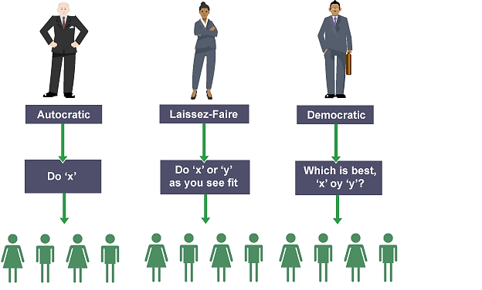
Leadership Styles-Autocratic

Slide 8
Leadership Styles-Democratic
Democratic
A democratic style of leadership involves:
Managers and employees working together to make decisions
A consultative management style
Employees are encouraged to communicate ideas to management
Employees feel motivated to work

Slide 9
Leadership Styles-Laissez-faire
Laissez-faire
Laissez-faire style of leadership involves:
Managers letting employees get on with their jobs with as little interference as possible
Employees are allowed to make decisions and solve problems on their own with little guidance from management
Management will only step in if they are needed

