Slide 1

ACADEMIC LISTENING
Source: "HFA's Tech-a-pedia 02" by hectorir is licensed under CC BY 2.0.

Slide 2
ACTIVE LISTENING
Active listening stands out as a crucial communication skill, playing a pivotal role in both academic and interpersonal settings within the university environment.
Its significance extends to various interactions, be they formal or informal, aiding in the comprehension and acquisition of information.
Whether engaging with professors, tutors, or fellow students, proficient listening skills will prove invaluable throughout your university journey.

Slide 3
ADEPT LISTENING: 2 PRIMARY DOMAINS
lectures, seminars, talks and presentations in which you will be listening (online or face-to face) to a speaker for an extended period of time with limited interaction opportunities
interpersonal interactions which involve exchange of turns (online or face-to-face) in which you will be alternating roles listening and speaking to other people (e.g. one-on-one conversations, tutorials, conversations in small groups)
Source: https://www.monash.edu/student-academic-success/improve-your-academic-english/strategies-for-listening-and-reading/listening-to-academic-english

Slide 4
AIMS of ACTIVE LISTENING
Maximise Effectiveness: : Active listening maximises the effectiveness of your listening in each of these situations whether you are listening to someone face-to-face or online.
Improved Comprehension: Active listening enhances students' ability to understand and internalize complex academic content, lectures, and discussions. It promotes more profound comprehension of course materials, leading to better academic performance.
Effective Participation: Active listening empowers students to engage meaningfully in classroom discussions, group projects, and academic debates. This active participation not only enriches their learning experience but also contributes positively to the overall academic environment.
Critical Thinking: Active listening encourages students to think critically and analytically. By closely attending to information, students can evaluate arguments, identify key concepts, and develop well-informed opinions, which are essential skills for academic success.

Slide 5
AIMS of ACTIVE LISTENING
Enhanced Problem-Solving: Active listening aids in identifying and understanding complex academic problems and challenges. It equips students with the ability to ask insightful questions, collaborate with peers, and find effective solutions to academic issues.
Effective Communication: Active listening fosters better communication skills, allowing students to articulate their ideas clearly and concisely in both written and oral forms. This skill is valuable for presenting research, writing papers, and participating in academic discussions.
Stronger Relationships: Building positive relationships with professors, mentors, and fellow students is crucial in academia. Active listening demonstrates respect and interest in others' perspectives, helping students establish supportive academic networks and mentorship opportunities.
Reduced Misunderstandings: By actively listening and seeking clarification when needed, students can minimize misunderstandings and miscommunications. This leads to fewer errors, conflicts, and confusion in academic interactions.

Slide 6
AIMS of ACTIVE LISTENING
Empathy and Inclusivity: Active listening encourages empathy and inclusivity by encouraging students to consider diverse viewpoints and engage respectfully with individuals from various backgrounds. This is particularly important in fostering a diverse and inclusive academic community.
Preparation for Future Success: Developing strong active listening skills in academia prepares students for success in their future careers. Effective listening is a valuable skill in professional settings, helping graduates excel in their chosen fields.
Lifelong Learning: Active listening is a skill that serves students well beyond their academic years. It promotes a mindset of lifelong learning and continuous improvement, which is essential in an ever-evolving world.

Slide 7
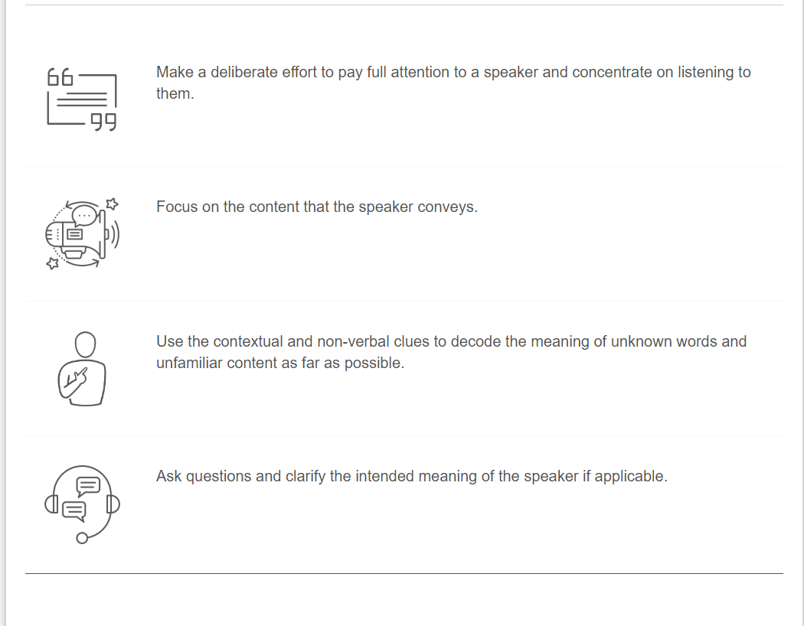
Tips to be an active listener
Source: https://www.monash.edu/student-academic-success/improve-your-academic-english/strategies-for-listening-and-reading/listening-to-academic-english

Slide 8

Active listening is a deliberate effort to listen with concentration, attention and focus to understand the meaning being conveyed by the speaker.
An active listener is content-oriented in that they listen to what the speaker says. They listen for information, ideas and explanations.
Additionally, an active listener focuses on how the speaker conveys their message. They observe both verbal and non-verbal cues used by the speaker.
Active listening will help develop your understanding of the content being presented and help you to understand its application to your learning.
Source: https://www.monash.edu/student-academic-success/improve-your-academic-english/strategies-for-listening-and-reading/listening-to-academic-english/active-listening

Slide 9

Active listening strategies

Slide 10
State of mind
Active listening strategies relate to what is going on in your head while you are listening.
Are you oriented to the subject under discussion or is your mind preoccupied with other matters?
To have an active listening state of mind:
Adopt an attitude of respect for the speaker and context.
Make the decision to pay attention and develop awareness of the length of your attention span.
Approach the speaker and context with an open mind and be aware of your assumptions, biases and prejudices and put them aside while you are listening.
Understand that oral communications can have a varied pace which requires patience from the listener.
Choose to ignore environmental distractions and draw your attention (including your eye focus) back to the speaker.

Slide 11
Non-Verbal Strategies
Non-verbal listening strategies are about what you do when you are listening and what you observe when you are listening.
These also include body language.
Are you upright and alert or are you slouched and sleepy? Use non-verbal listening strategies to demonstrate that you are actively listening. These also relate to what the speaker(s) does.
Choose a position where you can hear and see the speaker(s) clearly.
Adopt an alert body state. For example, sit up, lean slightly forward towards the speaker and face the speaker.
Take notes throughout the presentation.
Observe any visual aids to assist your understanding.
Avoid fidgeting. Fidgeting not only distracts your attention but also distracts that of the speaker and other audience members.
Acknowledge the speaker by making appropriate eye-contact, smiling, nodding, etc.
Observe the speaker’s non-verbal cues. Consider the messages being conveyed by the speaker’s body language, gestures, mood they radiate and how this adds to meaning.

Slide 12

Verbal Strategies
Verbal active listening strategies are about consciously listening to the language used and the sound features employed by the speaker (e.g. the rising and falling of their voice, emphasis they put on certain parts of their speech).
To engage actively in the listening process:
Be content-oriented and listen for how the content is organised.
Listen for key words.
Listen for repetition. The speakers often repeat their key messages a few times (not necessarily in the same words though).
Use a range of active listening phrases and expressions to demonstrate that you are engaged in listening.

Slide 13
Listening to lectures
For numerous students, participating in academic lectures can present a daunting challenge as they navigate the rapid flow of information provided by instructors, engage in discussions, and grapple with unfamiliar academic terminology that may initially seem perplexing.
In the realm of online education, the significance of listening skills has been further underscored. This pertains to maximising the benefits of Zoom classes and discussions.

Slide 14

Enhancing Lecture Experience through Active Listening Strategies
Delving into the various aspects of lectures, let's explore how the application of active listening strategies can significantly enrich your learning

Slide 15
Enhancing Lecture Experience through Active Listening Strategies
Engaging with the Content: Actively immerse yourself in the lecture content by focusing on the speaker's words, key concepts, and central ideas. Avoid distractions and maintain a keen interest in the subject matter.
Asking Questions: Don't hesitate to ask questions when clarification is needed. This proactive approach helps you grasp challenging topics and fosters a deeper understanding of the material.
Taking Effective Notes: Develop efficient note-taking techniques that capture the essential information. Summarize key points, examples, and explanations, ensuring your notes serve as valuable study aids.
Participating Actively: Engage in classroom discussions or online forums related to the lecture material. Sharing your thoughts, questions, and insights promotes a deeper exploration of the subject matter.
Clarifying Doubts: Seek clarification on any uncertainties promptly. Whether through post-lecture discussions with the instructor, peers, or online resources, addressing doubts ensures a solid grasp of the material.
Applying Critical Thinking: Apply critical thinking skills to assess the validity of arguments and concepts presented in the lecture. Evaluate evidence and consider alternative perspectives to foster a well-rounded understanding

Slide 16
Enhancing Lecture Experience through Active Listening Strategies
Reflecting on Key Takeaways: After the lecture, take time to reflect on the main takeaways and how they connect with your existing knowledge. This reflective practice reinforces learning and aids in knowledge retention.
Interactive Learning: Whenever possible, engage in interactive learning activities, such as group discussions, debates, or hands-on exercises related to the lecture content. These activities enhance comprehension and retention.
Creating Concept Maps: Visualize complex relationships and concepts by creating concept maps or diagrams based on the lecture material. This visual representation can help you organize information effectively.
Utilizing Resources: Make use of supplementary resources, such as textbooks, academic journals, or online materials, to deepen your understanding of the lecture topics. Diversifying your sources can provide additional insights.

Slide 17
BEFORE LISTENING
Check out the topic and do the required reading.
Check out the lecture slides as they will contain clues to important content to be covered in the lecture.
Think about what you already know about the topic.
Check out the weekly lecture topics and think about how the new topic is related to the previous lectures.
Prepare all you need to take notes during the lecture (e.g. gather the equipment to make notes including pen, notebook, laptop, iPad etc).
Source:https://www.monash.edu/student-academic-success/improve-your-academic-english/strategies-for-listening-and-reading/listening-to-academic-english/listening-to-lectures#tabs__2804010-02

Slide 18

WHILE LISTENING
During a lecture pay attention to how the ideas are organised (e.g. introduction/overview, thesis/hypothesis statement, supporting material, summary).
Listen for the key points, supporting points, evidence and facts.
Don’t expect to understand every single word that you listen to. If you don't understand a particular word, it doesn’t mean that you won’t understand the rest of what you are listening to. If you don’t understand something, don’t be fixated on it. Move on with the speaker and concentrate on listening to the rest of the content.
Use contextual clues to comprehend the message. For example, if you don’t understand a word, try to guess its meaning from the context.
Pay attention to the non-verbal cues of the speaker (e.g. body language and tone of voice).
Take notes.
Avoid distractions as far as possible (e.g. consider putting your phone away in your bag during the lecture, and closing off tabs or windows on your computer).
Source:https://www.monash.edu/student-academic-success/improve-your-academic-english/strategies-for-listening-and-reading/listening-to-academic-english/listening-to-lectures#tabs__2804010-02

Slide 19

AFTER LISTENING
Ask questions.
Revise your notes and add to them.
Following up on additional resources.
Reflect on what worked and what didn’t while you were listening. Think about whether and why you missed something important and think about what you can do differently next time to achieve a better outcome.
Source:https://www.monash.edu/student-academic-success/improve-your-academic-english/strategies-for-listening-and-reading/listening-to-academic-english/listening-to-lectures#tabs__2804010-02

Slide 20
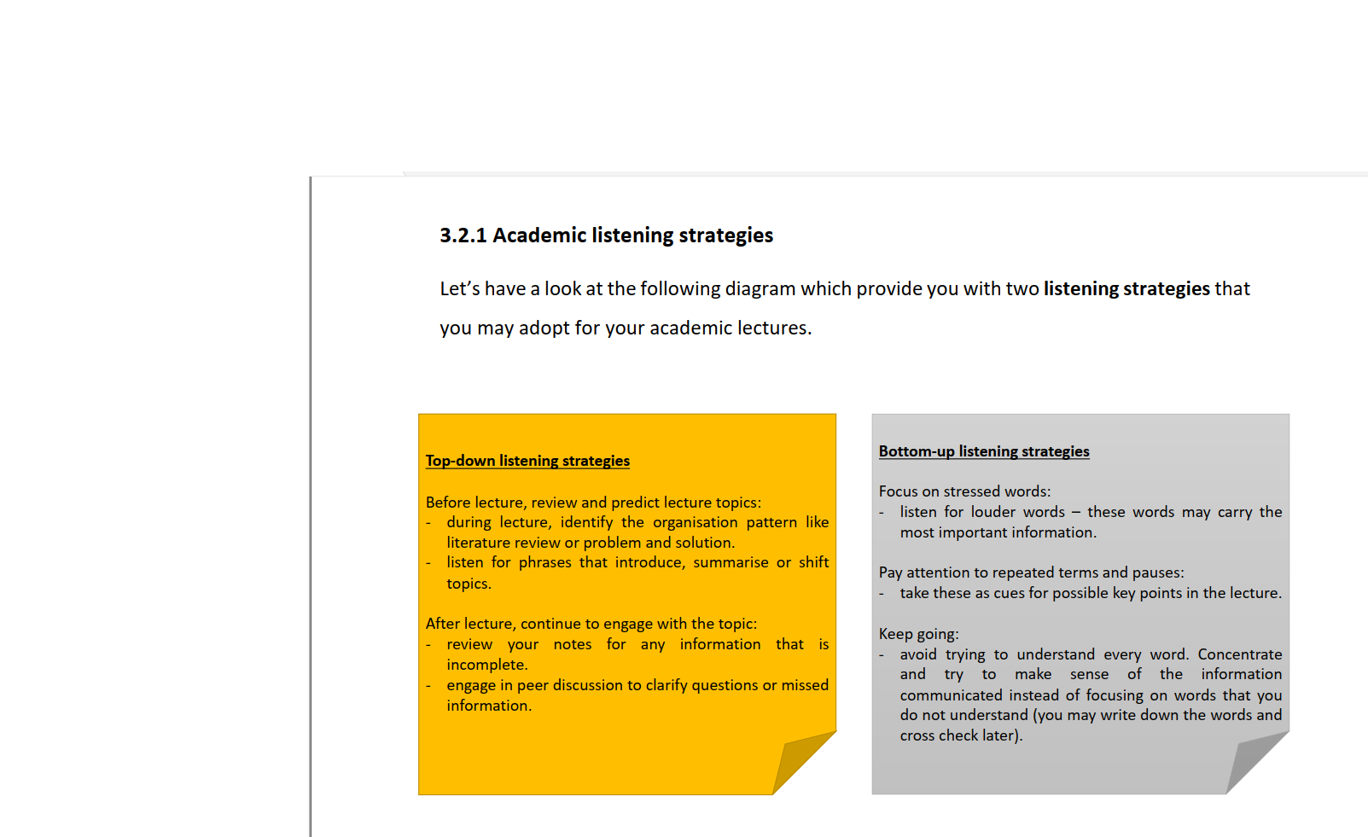

Slide 21

Listening in learning scenarios
Active listening strategies apply universally, whether in face-to-face or online scenarios.
Tips on listening in lectures and interpersonal interactions are equally relevant in both settings.
In online communication, non-verbal cues like body language are often limited compared to face-to-face interactions.
Online, you may need to rely more on auditory cues, such as voice patterns, volume, and emphasis due to potential lack of visual cues (e.g., when a video is off).
Paying attention to auditory non-verbal cues is crucial when listening online.
Online listening offers advantages, like the ability to pause and replay asynchronous recorded lectures or learning materials as needed.

Slide 22

Academic Listening © 2024 by Dr Shyama Ramsamy Goomany is licensed under CC BY-SA 4.0

