Slide 1

Principles of Management
Unit 1b
Types of Managers
N K BETCHOO

Slide 2
Types of Managers
Types of Managers
First line managers are usually called supervisors. In a manufacturing plant, the first-line manager is a foreman.
Higher up the organisation is the middle manager. Middle managers have titles such as project manager, division manager or unit leader. They can be sometimes called functional managers.
At the top of the organisation, managers typically have titles such as vice-president, president, chancellor, managing director.

Slide 3
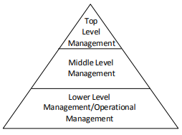
Types of Managers

Slide 4
Line Managers
First-Line Managers
First-line managers are the entry level of management, the individuals “on the line” and in the closest contact with the workers.
They are directly responsible for making sure that organisational objectives and plans are implemented effectively.
First-line managers are focused almost exclusively on the internal issues of the organisation and are the first to see problems with the operation of the business.

Slide 5
Middle Managers
Middle Managers
Middle managers have titles like department head, director, and chief supervisor.
They are links between the top managers and the first-line managers and have one or two levels below them.
An important function of middle managers is providing leadership, both in implementing top manager directives and in enabling first-line managers to support teams and effectively report both positive performances and obstacles to meeting objectives.

Slide 6
Top-level Managers
Top-level Managers
Top managers are ultimately responsible for the long-term success of the organisation.
They set long-term goals and define strategies to achieve them.
They pay careful attention to the external environment of the organisation: the economy, proposals for laws that would affect profits, stakeholder demands, and consumer and public relations.
They will make the decisions that affect the whole company such as financial investments, mergers and acquisitions.

