Slide 1

Metallic and Polymeric Materials for Civil Engineering
Unit 1 - Ferrous metals; Manufacturing and Microstructure
Dr. Roodheer BEEHARRY
Unit Tutor
Civil & Environmental Engineering Department

Slide 2
Content
Extractive metallurgy of iron
Types of Cast Irons
Steel Making processes
Crystal structure of Metals
Crystalline lattice in Metals
Crystalline lattice and metal properties
Crystal defects
Metal forming processes
Hot rolling & Cold rolling

Slide 3
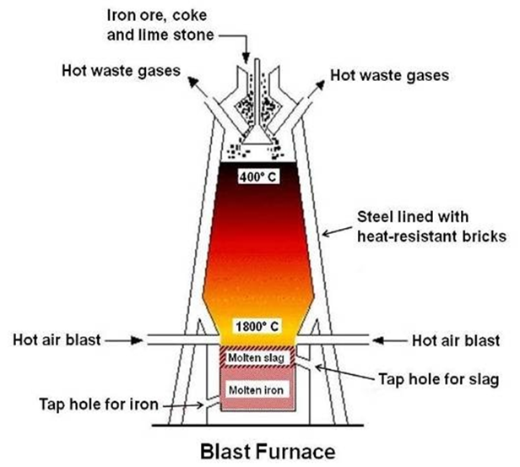
Extractive metallurgy of iron – Raw Materials
Raw materials in the blast furnace:
Iron ores (magnetite, hematite) – iron oxides with earth impurities;
Coke, which is both reducing agent and fuel, providing heat for melting the metal and slag.
Limestone – calcium silicate fluxes, forming a fluid slag for removal of gangue from the ore
CaCO₃ →CaO+CO₂
CaO+SiO₂ →CaSiO₃ (calcium silicate)
The calcium silicate melts and runs down through the furnace to form a layer on top of the molten iron.

Slide 4
Extractive metallurgy of iron-The Reduction of the Ore
Air heated to 1200°C is blown through the tuyeres at the bottom. Oxygen in air reacts with the coke, producing carbon monoxide: 2C + O₂= 2CO
Hot gases pass up through the descending materials, causing reduction of the iron oxides to iron according to the following reactions:
3Fe₂O₃ + CO = 2Fe₃O₄ + CO₂
Fe₃O₄ + CO = 3FeO + CO₂
FeO + CO = Fe + CO₂
For more details go to: https://en.wikipedia.org/wiki/Cast_iron

Slide 5
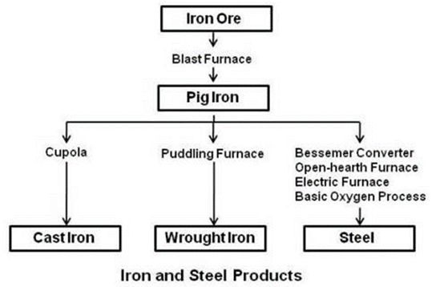
Pig Iron
It is the first product in the process of converting iron ore into ferrous metals. (crude iron - is an intermediate product)
It contains the following approximate levels of impurities:
3 to 5 per cent carbon,
up to 2 per cent manganese,
1 to 4 per cent silicon,
up to 0.12 per cent sulphur and
up to 2.5 per cent phosphorus
Pig iron is refined further for production of Cast Irons and/or Steels

Slide 6
Common Types of Cast Irons
The term cast iron identifies a large family of ferrous alloys.
In making cast irons from pig iron, coke and limestone are added to pig iron and scrap iron in a furnace.
The most common types of Cast Irons are: Grey cast irons, White cast irons, Malleable cast irons, Ductile cast irons & Alloy cast irons
Grey cast irons - produced at slow cooling and solidifying rate, and consists of ferrite and dispersed graphite flakes. Brittle, high compressive strength (600 – 750 Mpa), fatigue resistance and wear resistance. Its ultimate tensile strength varies between 120 - 300 Mpa. It is very runny when it is molten and doesn't shrink much when it solidifies. It is therefore ideal for making castings. The hardness ranges from 150 to 240 BHN. Common applications : manhole covers, guttering & drainpipes

Slide 7
Common Types of Cast Irons
White cast iron - obtained by rapid cooling and low Si content (< 1.0 %), most of the carbon exists as cementite instead of graphite. It is very hard and brittle. It has limited application due to the difficulty of machining. Mostly used for production of malleable cast iron and steel.
Malleable cast iron is produced by heat treatment of white cast irons. Whiteheart malleable cast iron is obtained when white cast iron undergo a heat treatment in a decarburizing atmosphere. Blackheart malleable cast iron is obtained when white cast iron is given a non-decarburizing heat treatment. Uses include pipe fittings, tools and wrenches.
Ductile cast iron (Nodular iron) obtains its special properties through the addition of magnesium and/or cerium to the grey iron before casting whereby the graphite forms as nodules. Uses include heavy duty gears, pipes and pipe fittings, and bollards near vehicular traffic.
Alloy cast irons are classified as two types: corrosion-resistant and elevated-temperature service. Corrosion-resistant alloyed cast iron parts are used in environment such as sea water, sour well oils, acids and alkalis. Elevated-temperature service alloyed iron can resist heat up to 600°C.

Slide 8
Steel Making – Common processes
Steel making involves removing impurities (excess C, Mn, P, S & Si) by chemical reaction, from pig iron (with steel scrap), made by the Bessemer converter, Siemens-Martin open hearth, basic oxygen ((L D converter) and electric furnace processes.
The Bessemer process consists of blowing air through molten pig iron contained in a special furnace known as a converter.
The LD-converter is a refined version of the Bessemer converter where blowing of air is replaced with blowing oxygen.
The Siemens-Martin open hearth furnace is used in the open hearth process whereby pig iron, steel scrap are melted in an open hearth.
The Electric Furnace Process, the heat required is generated by electric arcs struck between carbon electrodes and the metal bath. Used for making highly alloyed steel such as stainless, heat-resisting and high-speed steels.

Slide 9
Solidification & Grain Growth in Metals
During solidification the atomic arrangement changes from a short-range order (random) to a long range order or crystal structure.
Metals are aggregations of many crystals, commonly called grains.
Grains are formed because solidification does not take place all at once but through nucleation at multiple locations in the molten metal mass.
Nucleation occurs when a small nucleus begins to form in the liquid, the nuclei then grow as atoms from the liquid are attached to it.
Multiple crystals begin to grow simultaneously in the liquid.
Grains grow until they interfere with their neighbours where further growth ceases forming grain boundaries with varying grain sizes.
Grain (crystal) structure of a solid is an arrangement of differently oriented grains, of varying grain sizes, surrounded by grain boundaries where there are lines of mismatch in the atomic arrangement.

Slide 10
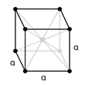
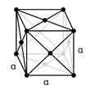
Crystalline lattice in Metals (steels)
Crystalline lattice - upon solidification, the atoms position themselves in an ordered repetitive 3-dimensional array.
Within each grain the atoms are arranged in a regular lattice, the orientation of the crystal lattice differs from grain to grain.
The smallest possible part of a crystal lattice, determining the structure, is called unit cell.
Many metals (steels) form body-centered-cubic (BCC) or face-centered-cubic (FCC) structures.
The BCC unit cell has atoms at each of the eight corners of a cube plus one atom in the center. Each of the corner atoms is the corner of another cube thus shared among eight unit cells. (BCC unit cell = a net total of 2 atoms).
The FCC unit cell has atoms at each of the corners and the centers of all the cubic faces. Sharing of corner atoms same as BCC. Each of its six face centered atoms is shared with an adjacent atom. (FCC= total 4 atoms)

Slide 11
2 important characteristics of a crystal structure
Coordination number - For metals, each atom has the same number of nearest-neighbour or touching atoms, which is the coordination number.
The coordination number for the BCC crystal structure is 8; each central atom has as nearest neighbours 8 corner atoms.
For FCC, the coordination number is 12.
The Atomic Packing Factor (APF) is the sum of the sphere volumes of all atoms within a unit cell (assuming the atomic hard-sphere model) divided by the unit cell volume.
For the BCC lattice, the atomic packing factor is 0.68.
For the FCC lattice, the APF is 0.74, which is the maximum packing possible for spheres all having the same diameter. Metals typically have relatively large atomic packing factors to maximize the shielding provided by the free electron cloud.

Slide 12
Crystalline lattice and Metal Properties
The BCC arrangement does not allow the atoms to pack together as closely as the FCC.
When a metal is deformed, the planes of atoms must slip over each other, and this is more difficult in the BCC structure.
Lattice structures with closely packed planes allow more plastic deformation than those that are not closely packed.
Cubic lattice structures allow slippage to occur more easily than non-cubic lattices - symmetry provides closely packed planes in several directions.
A FCC lattice will exhibit more ductility than a BCC as the latter lattice, although cubic, is not closely packed.
Metals which have a BCC structure are usually harder and less ductile than close-packed metals.
Also, fine-grained materials are stronger than coarse-grained materials of the same composition.

Slide 13
Crystal Defects
A perfect crystal, with every atom of the same type in the correct position, does not exist. There are 3 classes of defects.
Point defects, which are places where an atom is missing or irregularly placed in the lattice. Point defects include lattice vacancies, self-interstitial atoms, interstitial impurity atoms and substitution impurity atoms.
Linear defects, which are groups of atoms in irregular positions, commonly called dislocations. (Edge & Screw dislocations)
Planar defects, which are interfaces between homogeneous regions of the material. Planar defects include grain boundaries.
Defects have significant (positive) effects on the properties of metals by making it possible to influence the characteristics of a metal by mechanical (strain hardening),thermal processing and/or alloying.

Slide 14
Crystal Defects & Plastic Deformation
On a microscopic scale, plastic deformation corresponds to the net movement of large numbers of atoms in response to an applied stress whereby interatomic bonds must be ruptured and then re-formed.
In crystalline solids, plastic deformation most often involves the motion of dislocations (linear crystalline defects).
Dislocation movement produces additional dislocations, and when dislocations run into each other, it often impedes movement of the dislocations. This drives up the force needed to move the dislocation or, in other words, strengthens the material.
Millions of dislocations result in plastic forming operations such as rolling and extruding.
Crystalline defects can allow the flow of the material, or trap it and be an obstacle to crack propagation and deformation, and be responsible for residual and internal stresses.

Slide 15
Crystal Defects & Strengthening of Steels
The strength of a steel can be described as the resistance against the onset of plastic deformation under an external load.
Plastic deformation - the movement of dislocations through the metal lattice which enables single lattice planes to slip consecutively over one another.
If this motion is hindered by lattice defects, a higher external load must be applied so that the dislocations can overcome the obstacles.
Increasing the strength of steels – using defects so as to hinder the movement of dislocations.
Obstacles to dislocation motion can be classified according to Table below.
Dimension | Generator | Mechanism
0 (point) | solute atoms | solid solution hardening
1 (linear) | dislocations | strain hardening
2 (plane) | grain boundaries | grain refinement (reducing sizes)
3 (spatial) | particles | precipitation/dispersion hardening

Slide 16
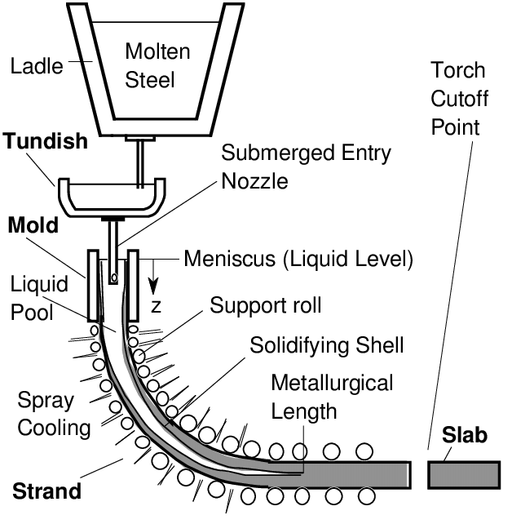
Steel solidification – Continuous Casting
Continuous casting produces semi-finished products of high quality due to directional solidification. [Ingot casting - individual moulds are filled with molten steel to produce steel ingots]
Molten metal – poured into a tundish, flows through a water-cooled mould and solidifies there in the peripheral zone. In an arch-shaped cooling chamber, the strand is deflected and sprayed with water before it is finally straightened and cut to length.
Semi-finished products – Blooms (≥ 150 mm²), Billets (≥ 40 mm²) & Slabs (rectangular cross section of ≥ 250 mm width and thickness ≥ 40 mm)

Slide 17
Steel forming processes – Hot Working
Metal forming is used to create various products, including structural steel shapes, rails, tubes, pipes, metal sheets, sheet piles, fasteners, wires, etc.
Metal forming involves the reshaping of metals while still in the solid state.
Hot working deforms metal above its recrystallization temperature (0.5 T_{m} - 0.75 T_{m}) whereby new stress-free grains are formed in the metal.
Hot working is best used when a large amount of deformation is needed. It takes a smaller amount of force to form hot metal, and hot forming allows the metal to stretch far more than in cold forming. It doesn’t work harden the metal, which allows the metal to keep its ductility.
However, it produces a rougher surface finish, lower dimensional accuracy, surface oxidation and a shorter tool life.
The principal methods of hot working are: Rolling, Piercing, Drawing, Spinning, Extruding & Forging.
Hot shortness - When a metal is worked at or near its melting point, it crumble into pieces during deformation.

Slide 18
Steel forming processes – Cold Working
Cold working is the process of metal forming in which deformation of the metal occurs below its recrystallization temperature (room temp - 0.3 T_{m} )
Cold-working is employed chiefly as a finishing operation, following the shaping of the metal by hot-working.
It allows more accurate dimensions to be maintained and a smooth surface finish is produced, requiring minimum machining afterwards.
It increases the tensile strength, yield strength and hardness of steel (work hardening), but lowers its ductility.
Internal stresses are set up which remain in the metal unless they are removed by proper heat-treatment.
The amount of forming that can be accomplished is limited due to strain hardening.
The principal methods of cold-working are : Cold rolling, Cold forging, Cold drawing, Cold bending, Cold spinning, Cold extruding & Cold Squeezing.

Slide 19
THANK YOU

