Slide 1

Principles of Management
Unit 5
Organisational Concepts
N K BETCHOO

Slide 2
The function of Organising
Organising is concerned with the firm’s activities. It is a process for:
determining, grouping and structuring activities.
devising and allocating roles arising from the grouping and structuring of activities.
assigning accountability for results to both groups and individuals.
determining detailed rules and systems of working, including those for communication, decision-making and conflict-resolution.

Slide 3
The function of Organising
Organising basically refers to the allocation of tasks and activities to the right person in the firm.
It also involves preparing time tables and carrying out work scheduling.
In the role of the organiser, the manager must be capable of designing and implementing an organisation structure that will highlight the role and position of each individual in the firm.

Slide 4
Organisation Structure and Design
Defining organisation structure and design
An organisation structure is expressed by its degree of complexity, formalisation and centralisation.
Complexity
Complexity considers the amount of differentiation in an organisation. The more differentiated and tall and organisation, the more complex it becomes. Simple and lean oreganisations have a lesser degree of complexity..

Slide 5
Formalisation
Formalisation
Formalisation refers to the degree to which an organisation relies on rules and procedures to direct the behaviour of employees.
Normally, in taller structures there can be a higher degree of formalisation.
In smaller and flatter organisations, this may be reduced to a great extent.
Formalisation may be acceptable in certain instances but not necessarily fit in all situations.

Slide 6
Centralsation and Decentralisation
Centralisation
Centralisation is concerned with the concentration of decision-making authority in upper management. In the former communist system, there was a high degree of centralisation.
Power and authority resided in the hands of leaders and presidents. The opposite is decentralisation.
Decentralisation
Organisations that develop and expand definitely need to decentralise their operations for two reasons. They want to produce elsewhere at a lower price.
Such organisations are closer to the needs of the market.

Slide 7
Authority and Responsibility
BASIS FOR COMPARISON | AUTHORITY | RESPONSIBILITY
Meaning | Authority refers to the power or right, attached to a particular job or designation, to give orders, enforce rules, make decisions and exact compliance. | Responsibility denotes duty or obligation to undertake or accomplish a task successfully, assigned by the senior or established by one's own commitment or circumstances.

Slide 8
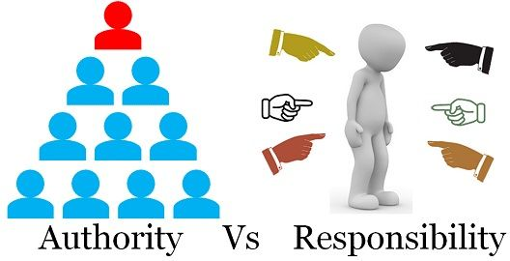
Authority and Responsibility

Slide 9
Span of Control
A span of control refers to the number of subordinates under the manager’s direct control.
The span of control refers to the number of subordinates that can be managed effectively and efficiently by supervisors or managers in an organisation.
Span of control depends upon: organisation size, nature of organisation and job, skills and competences of manager and employee.

