Slide 1
Marketing Planning
Unit III
Marketing Audit, Analytics and Research

Slide 2
3-Step Proccesses
Marketing Audit
Marketing Analysis
Marketing Research

Slide 3
The Business Environment
Macro Environment – External , uncontrollable environment
  General External - PESTEL
  Specific External – Market Research, STP, Porter’s 5 Forces
Micro Environment – Internal and controllable
  The 7Ps, Resource Based View, SWOT, the 7S frameworks and VRIO are most common

Slide 4
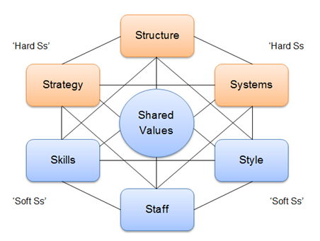
Mc Kinsey 7S Framework

Slide 5
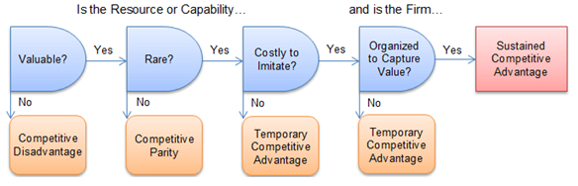
VRIO Framework

Slide 6
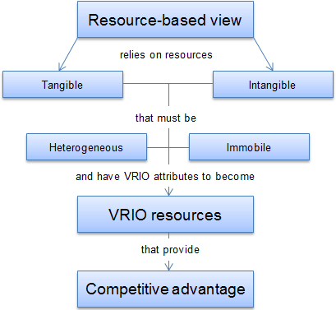
Resource Based View Model

Slide 7
Analysing Competitors
Perfect Competition - there are lots of buyers and sellers,
  Products tend to be undifferentiated and prices set by the market forces
Monopolistic Competition - limited numbers of competitors,
  They differentiate their product through branding, packaging and advertising to win short-term competitive advantage and price freedom.
Oligopolistic Markets - Markets dominated by a handful of large suppliers, each able to influence price or output in the market.
  These suppliers often collude to avoid price wars, acting as a monopoly to limit output and keep prices up.
Monopoly - When one firm dominates the market, controlling output and prices.
  Often run by the public sector and feature price discrimination in some form.

Slide 8
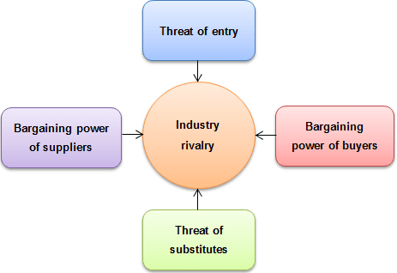
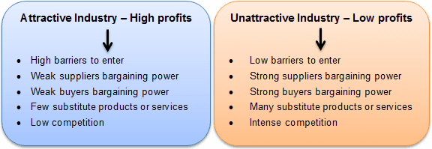
Porter’s 5 Forces

Slide 9
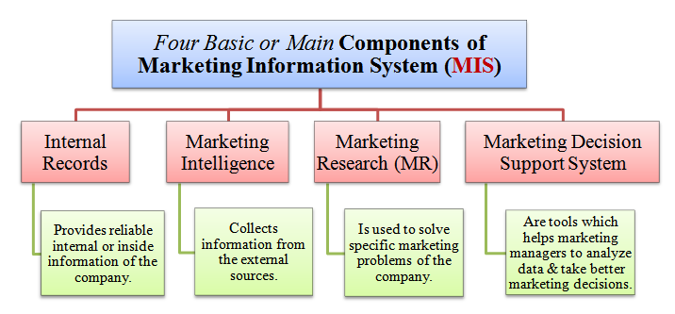
The MKIS

Slide 10
Types of Research
Quantitative
Qualitative
Formal / Informal
Market
Marketing

Slide 11
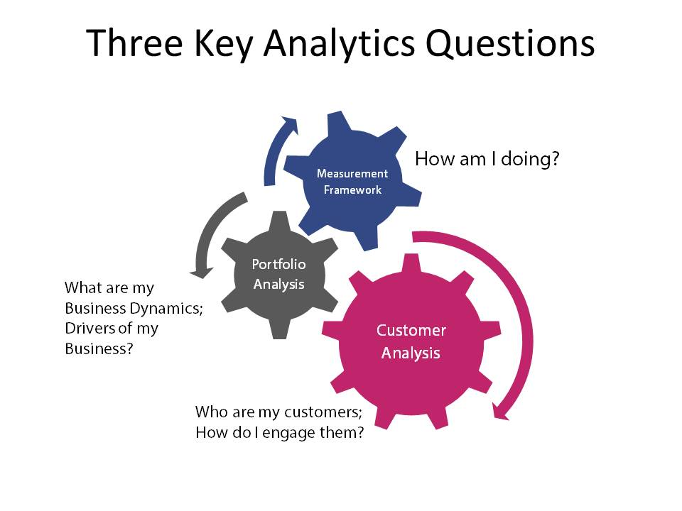

Slide 12
What is Big Data?
Big data means data exhibiting one or more of the following properties:
Velocity – the data comes in quickly through multiple sources ie, online systems, sensors, social media, web clickstreams, smartphones, etc., and should be analysed quickly
Variety – data is made up of multiple data types – structured, semi-structured, and unstructured data
Volume – Big data can involve terabytes to petabytes (and more) of information
Complexity – Big data involves complexity manifested in both geographical and multi-data center data distribution, and cloud interaction etc.

Slide 13
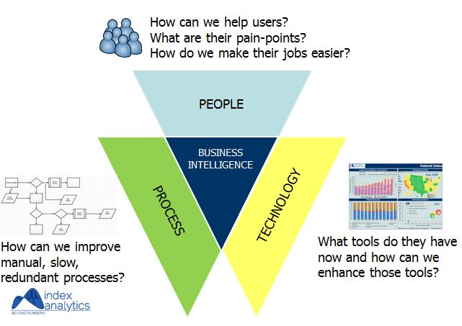

Slide 14
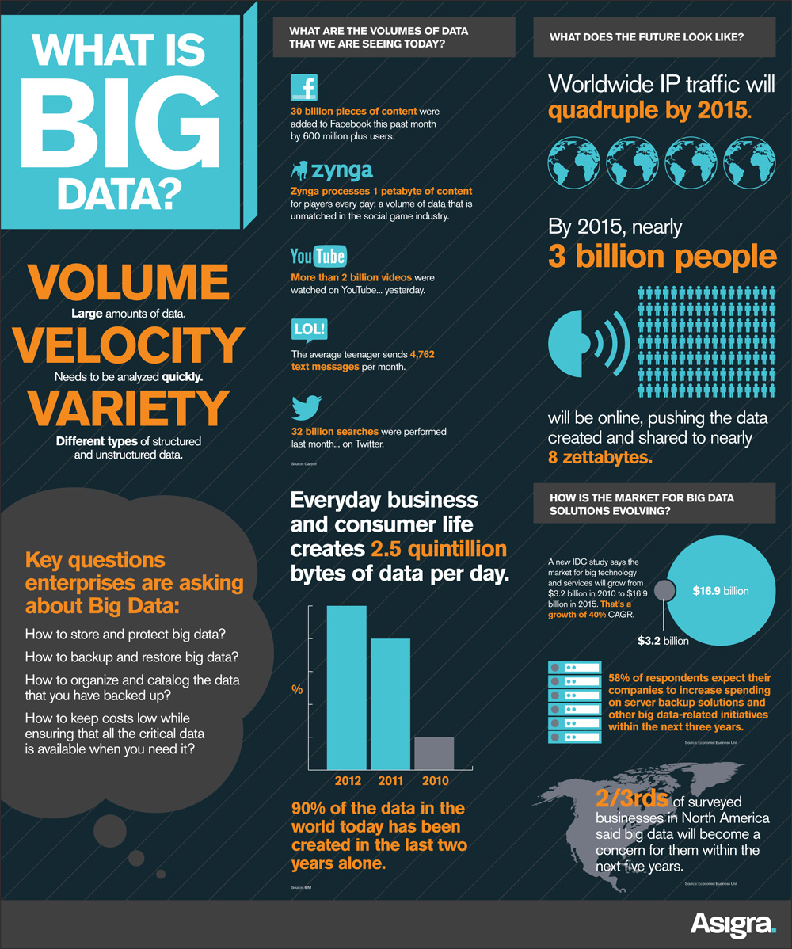

Slide 15
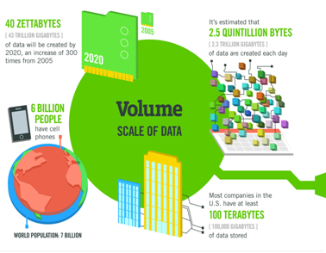
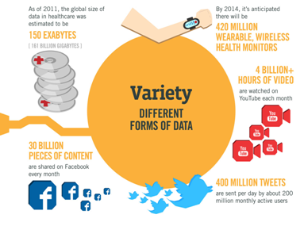
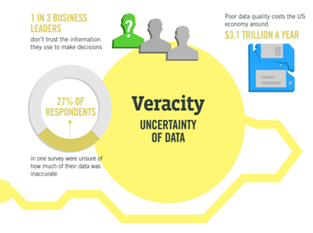
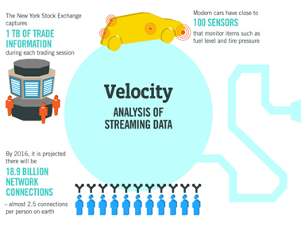

Slide 16
Strategic Marketing
Unit IV
Marketing Strategic Choice

Slide 17
Evaluating Strategic Options
Analysis of the opportunities and internal capabilities identified in the marketing audit, to assess the most promising directions for the business to follow.

Slide 18
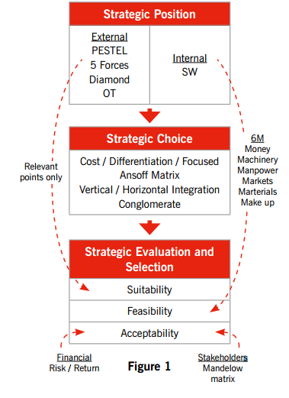

Slide 19
Evaluating Strategic Options
The most appropriate options are evaluated in terms of:
  their suitability to the organisation’s situation
  their feasibility in terms of resources and competencies, and
  their acceptability to the key stakeholder groups, particularly shareholders and customers

Slide 20
Nature and Scope of Strategic Options
J Scholes definition – “decisions about an organisation’s future and the way in which it needs to respond to the many pressures and environmental influences”.
Three overarching choices:
  how an organisation positions itself in relation to competitors
  products and markets for an organisation
  how strategies are to be pursued

Slide 21
Strategic Choices
Bases of Competitive Strategy
The choices as to how an organisation positions itself in relation to competitors
Strategy Directions
The choices of products and markets available to an organisation
Methods for Pursuing Strategies
The choices about how strategies are to be pursued

Slide 22
Organisational Stance and Positioning
Organisations may adopt one of three positions in their market:
  market leaders
  market followers
  market nichers
Two types of strategic response are postulated - attack and defense - depending on the circumstances.

Slide 23
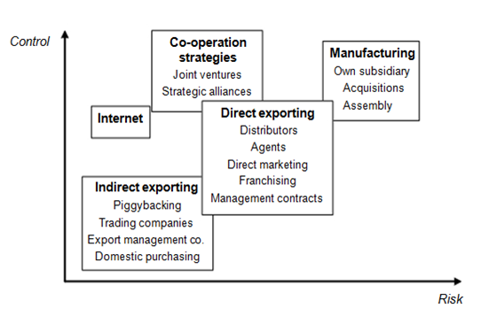
Market Entry Alternatives

Slide 24
Market Entry Alternatives
They are achieved this through:
(a) Exporting - selling domestically developed and produced goods and services abroad.
(b) International niche markets - marketing a differentiated product or service overseas using the full range of market entry and marketing mix options.
(c) Direct marketing - Especially through the Internet, which allows firms to market products and services globally from a domestic location (organisations can also source products internationally).
(d) Through the International supply chain of a MNE - For example, piggybacking an MNE's international development programme

Slide 25
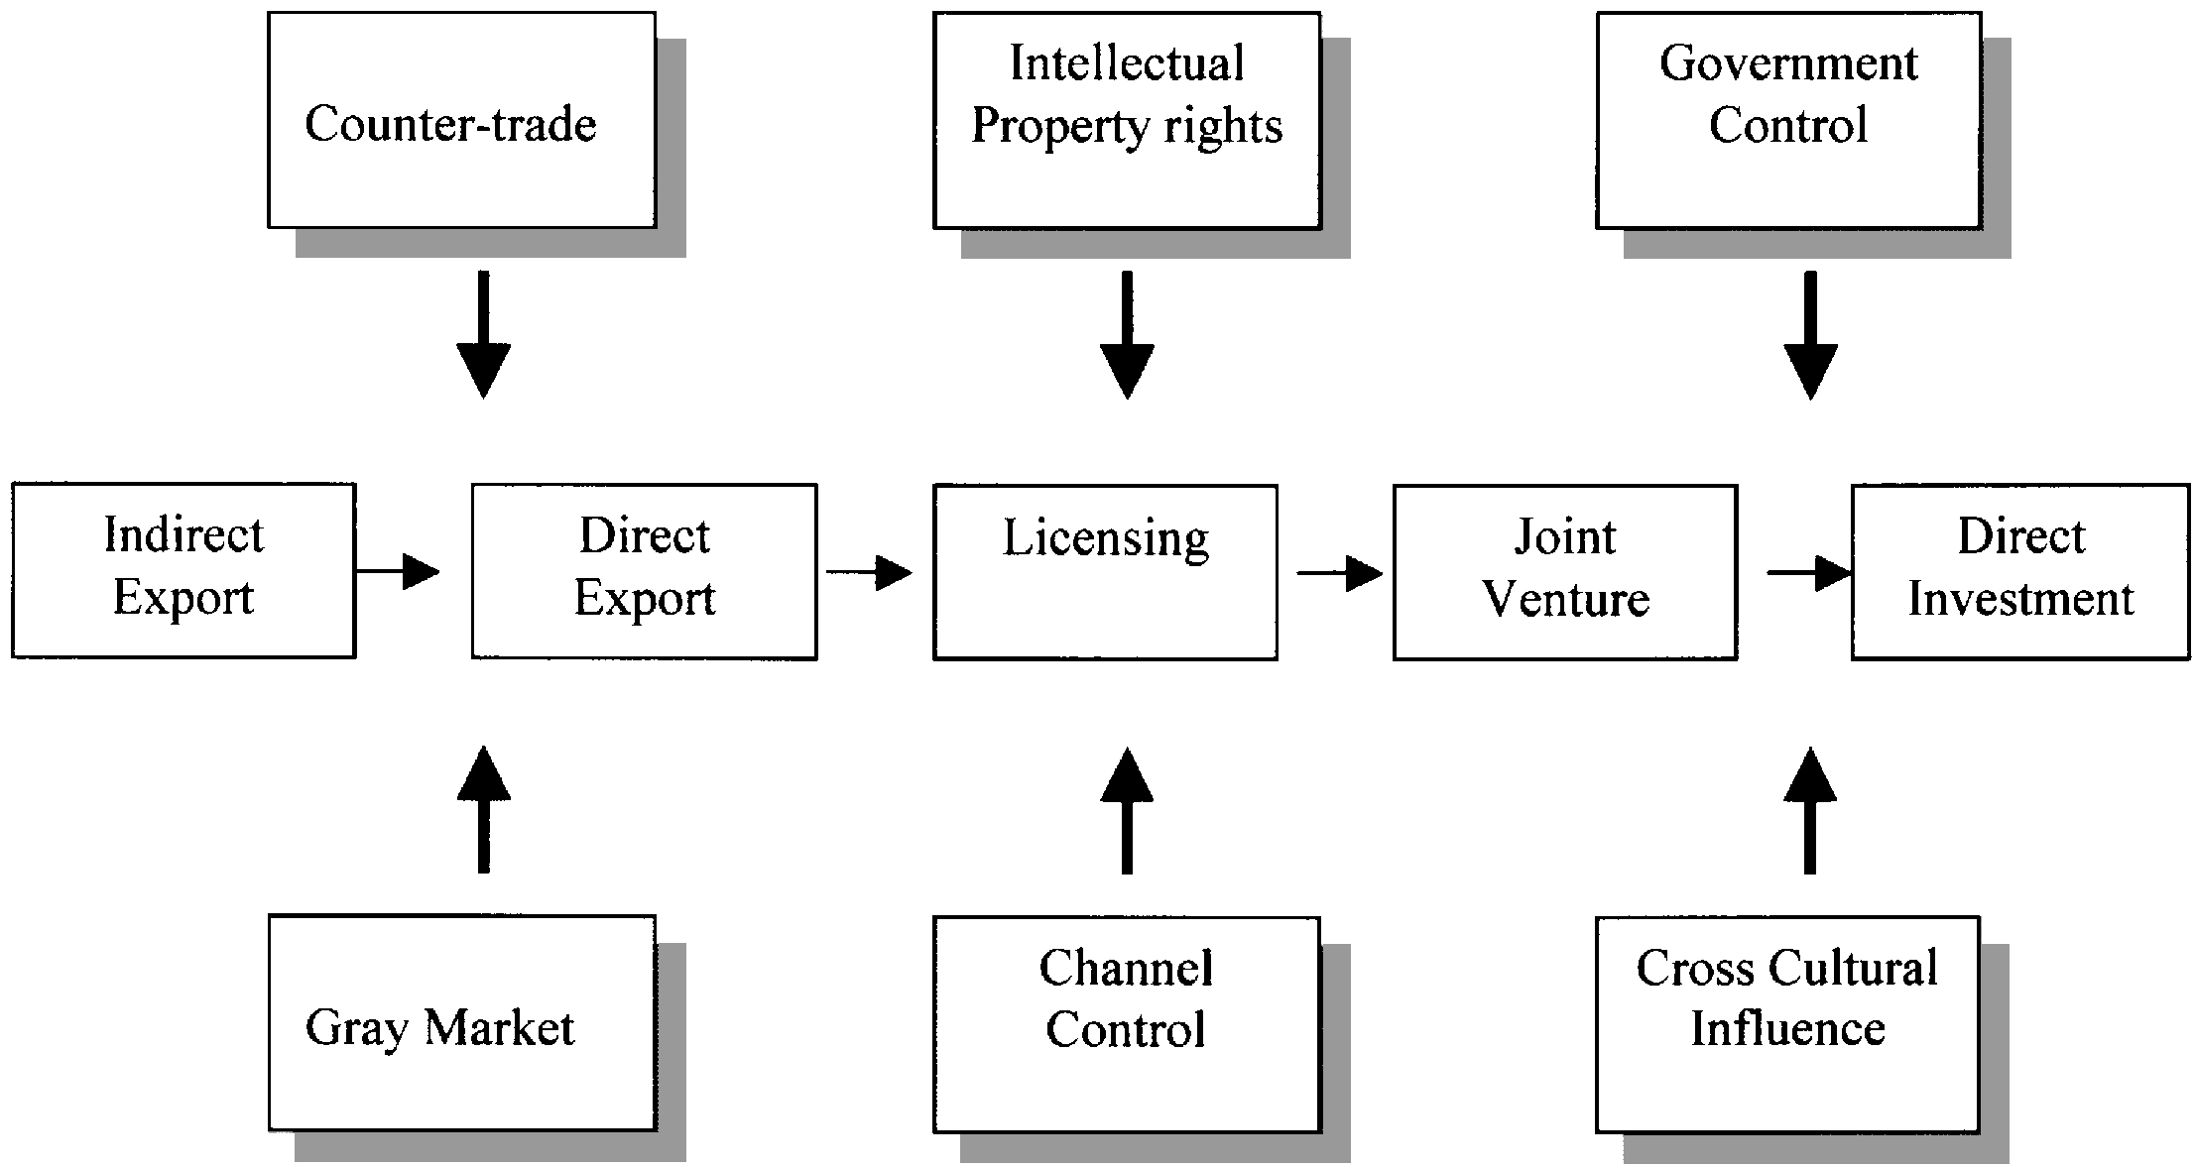
Market Entry Alternatives

Slide 26
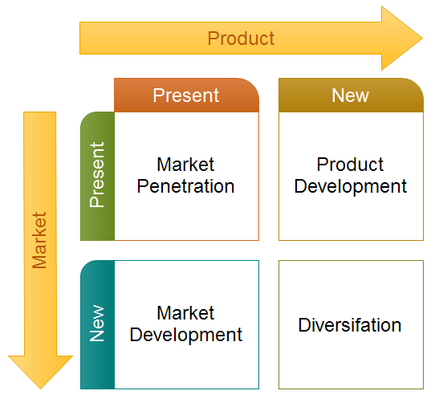
The Ansoff Growth Matrix

Slide 27
The Ansoff Growth Matrix
Product Innovation
Consolidation
Market Sophistication

Slide 28
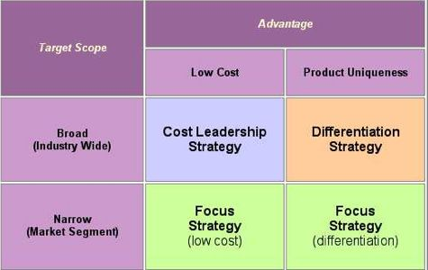
Porter’s Generic Strategies

Slide 29
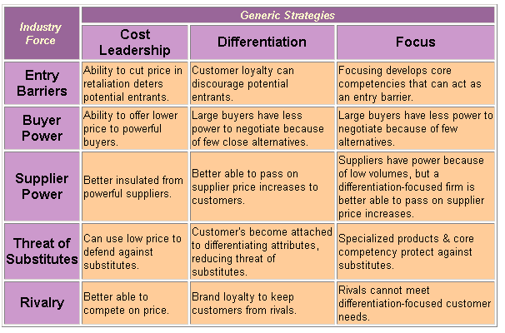
Porter’s Generic Strategies

Slide 30
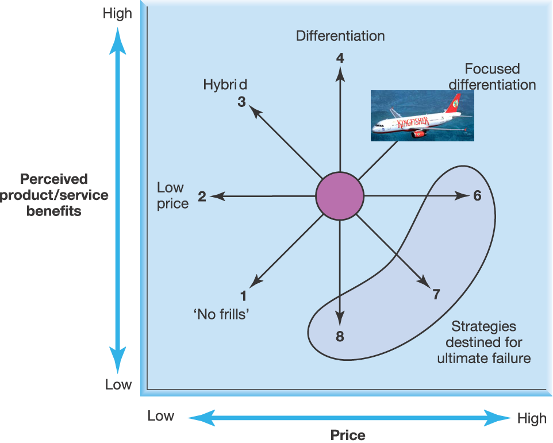
Bowman’s Strategy Clock

Slide 31
Profit Impact of Marketing Strategy
PIMS is an effort to examine the profit performance of different marketing strategies.
  It seeks to quantify the behavior of factors that influence business performance.
Each PIMS "business" is defined as a division, product line, or other profit center within its parent company, selling a distinct set of products or services to an identifiable group of customers in competition with a well-defined set of companies.

Slide 32
PIMS
PIMS is a "programme [not really a model] to determine how profit impacted on marketing strategy and vice versa.
The programme, which is still continuing, has four main areas of strategic planning under investigation which can be of use to businesses when they are selecting strategies.
  Forecasting profits
  Allocating resources
  Measuring performance
  Appraising new business propositions.
The main findings of the PIMS programme have been that profitability is influenced by:
  Competitive position (market share and product quality)
  Production structure
  Attractiveness of the target market.

