Slide 1

Metallic and Polymeric Materials for Civil Engineering
Unit 2 - Engineering Properties and Classification of Steels
Unit Tutor: Dr. Roodheer BEEHARRY
Civil & Environmental Engineering Department

Slide 2
Content
Structure-Sensitive and Structure-Insensitive Properties
Physical properties of Steel
Mechanical properties of Steel
Factors that influence Mechanical Properties of steel
Dislocations and Plastic Deformation
Stress-Strain Curve for Tensile Loading (ductile material)
True and Engineering Stress & Strain
Ductility, Resilience & Toughness from σ - ε curve
Influence of Temperature & Strain Rate on Strength
Creep & Graphitization in ferrous metals
Toughness & Hardness testing
Mechanisms for Strengthening of Metals
Classification of Steels - European standard EN10020
Designation of Steels according to EN 10027-1:2016
Designation of Steels according to Chemical Composition
Classification of Stainless Steels
Delivery Conditions of Steel products

Slide 3
Structure-Sensitive and Structure-Insensitive Properties
The structure-insensitive properties are those which are not influenced significantly by changes in microstructure. It is factual that many of the physical properties of materials, e.g. elastic modulus, bulk density, specific heat, and coefficient of thermal expansion, do not vary significantly, even if the material is subjected to different working and/or heat treatment processes. This insensivity is present despite the fact that the latter processes cause substantial changes in the crystal structure . On the other hand most of the mechanical properties are very dependent on these structural changes. For instance, the yield strength, ductility and fracture strength are seen to be structure-sensitive.
Mechanical properties are structure sensitive in the sense that they depend upon the crystal structure and also upon the nature and behaviour of the imperfections (Unit 1) which exist within the crystal itself or at the grain boundaries.

Slide 4
Physical properties of Steel
The physical properties of materials are those properties that are not directly related to strength and may generally be determined by methods which do not destroy the material under investigation. Among the more common physical properties are; colour, density, specific gravity, grain structure, heat and electrical conductivity, and magnetism.
Typical Physical Properties of Carbon Steel
Physical Property | Value
Density @ room temperature | 7.85 x 10³ kg/m³
Specific gravity @ room temperature | 7.85
Melting point | 1425 ⁰C
Thermal Conductivity @ room temperature | 50 W/m K
Shear modulus @ room temperature | 75.0–80.0 GPa
Coefficient of Linear Expansion | 11-12 x 10⁻⁶ / ⁰C
Poisson’s Ratio @ room temperature | 0.29

Slide 5
Mechanical properties of Steel
Mechanical properties determine a material’s behaviour when subjected to mechanical stresses. Properties include elastic modulus, ductility, hardness, and various measures of strength.
The properties of structural steel result from both its chemical composition and its method of manufacture , including processing during fabrication.
The mechanical properties are derived from minimum values specified in the relevant product standard.
Product standards define the limits for composition, quality and performance - these limits are used or presumed by structural designers.
Mechanical properties desirable to the designer, such as high strength, usually make manufacturing more difficult.
Carry out the activity ‘Glossary of mechanical properties’ assignment for a full list and definitions of mechanical properties of metallic materials.

Slide 6
Factors that influence Mechanical Properties (I)
Steel derives its mechanical properties from a combination of chemical composition, heat treatment and manufacturing processes.
Composition effects - The strength of steel can be increased by the addition of alloys such as Mn, Nb & V but adversely affect other properties, such as ductility, toughness and weldability.
Minimizing the sulphur level can enhance ductility.
Toughness can be improved by the addition of nickel.
The chemical composition of each steel specification is thus carefully balanced and tested during its production to ensure that the appropriate properties are achieved.
The alloying elements also produce a different response when the material is subjected to heat treatments involving cooling at a prescribed rate from a particular peak temperature.

Slide 7
Factors that influence Mechanical Properties (II)
Mechanical working takes place as the steel is being rolled or formed. The more steel is rolled, the stronger it becomes.
Steel manufacturing (Unit 1)may involve both heat treatment and mechanical working – critical for mechanical properties of the metal.
Heat treatment effects - explained by the various production processes used in steel manufacturing, principal ones are as follows;
As-rolled steel (typical rolling finish T= 750°C & allowed to cool naturally)
Normalized steel ([ref. Unit 3] refines the grain size and improves the mechanical properties, mostly toughness. Have an 'N' designation).
Normalized-rolled steel(Rolling finish T > 900°C after rolling is completed, similar effect as normalizing. Also have an 'N' designation).
TMR steel (low carbon steels having toughness and ductility but also high strength achieved by maximizing grain refinement. Have 'M' designation)
Quenched and tempered steel ([Unit 3]. Have ‘Q' designation).

Slide 8
Dislocations and Plastic Deformation
The mechanical behaviour of steel - both elastic and plastic deformation.
Elastic deformation is reversible. Hooke's laws connect elastic strain with stress as follows: (i) σ = E . ε (ii) τ = G . γ , where σ and ε are the uniaxial stress and strain, E is the Young's modulus(210000 N/mm²) . τ and γ, the shear stress and shear strain, G is the shear modulus (80000 N/mm²)
The initial response of a crystal lattice to loading is elastic. Beyond the yield stress, the deformation becomes elastic-plastic, whereby the crystallographic planes move against each other.
The presence of lattice defects called dislocations facilitates the slipping of crystallographic planes. Dislocations distort the surrounding lattice elastically which interact with other defects (solute atoms, other dislocations, grain boundaries & precipitates) and impede dislocation movement making plastic deformation more difficult.

Slide 9
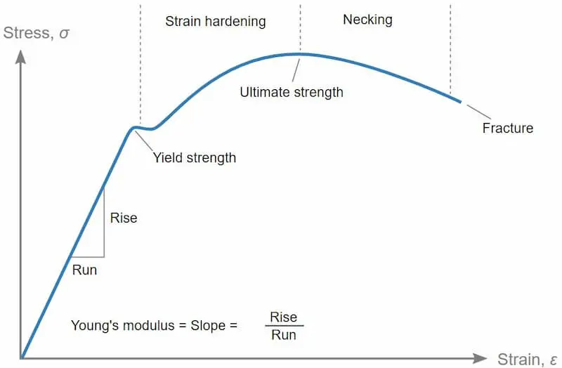
Stress-Strain Curve for Tensile Loading (ductile material)
The stress-strain curve provides design engineers with important parameters needed for design such as strength, toughness, elasticity, yield point, strain energy, resilience, and elongation during load.
Stress and strain curves for brittle materials are different.
Major points on a stress-strain curve:
Proportional Limit - it is the point up to
which stress is directly proportional to strain.
Elastic Limit – As tensile stress increase
beyond the proportional limit, the stress-strain
relationship deviates from Hooke’s law. The
strain increases at a faster rate than stress
which manifests itself as a mild flattening of the curve, the elastic limit. Although the proportionality of stress to strain is lost, the property of elasticity isn’t, and on the removal of load, the metal still returns to its original dimensions.

Slide 10
Stress-Strain Curve for Tensile Loading (ductile material)
Yield point – It’s the transition from elastic behaviour to plastic behaviour.
Upper yield point corresponds to the load reached just before yield starts.
Lower yield point corresponds to the load required to maintain steady yielding and should be used to determine the yield strength of the material.
Less ductile materials (high carbon steels) do not have a well defined yield point and the proof stress is used instead, corresponding to 0.2 % strain.
Strain hardening is said to occur when the number of dislocations in the material becomes too high and they start to obstruct each other’s movement. The material constantly rearranges itself and tends to harden.
Tensile Strength is the maximum stress or strength of the material. After this point the cross section of the specimen start decreasing - necking.
Fracture ultimately occurs at the neck. For engineering stress-strain curve it has magnitude below the ultimate strength, but for true engineering stress-strain curve it is above the Tensile Strength of the material.

Slide 11
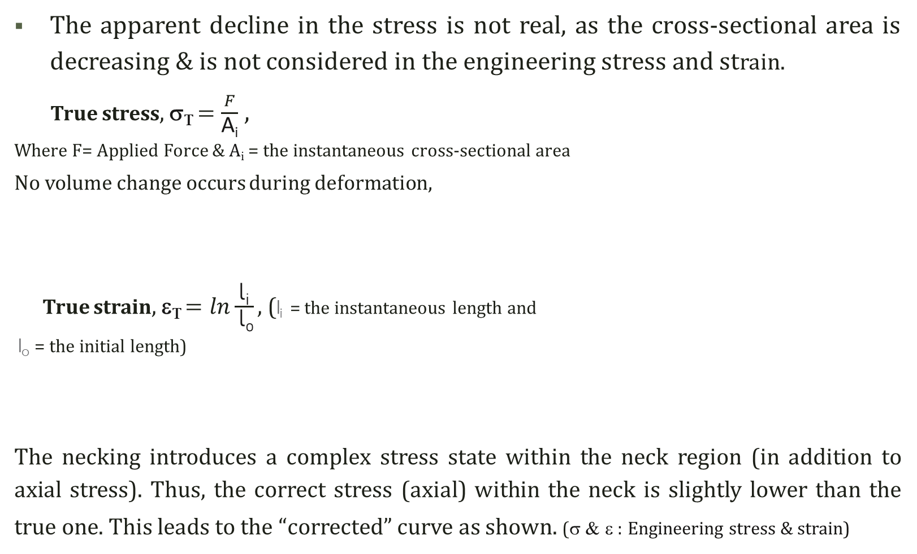
True and Engineering Stress & Strain

Slide 12
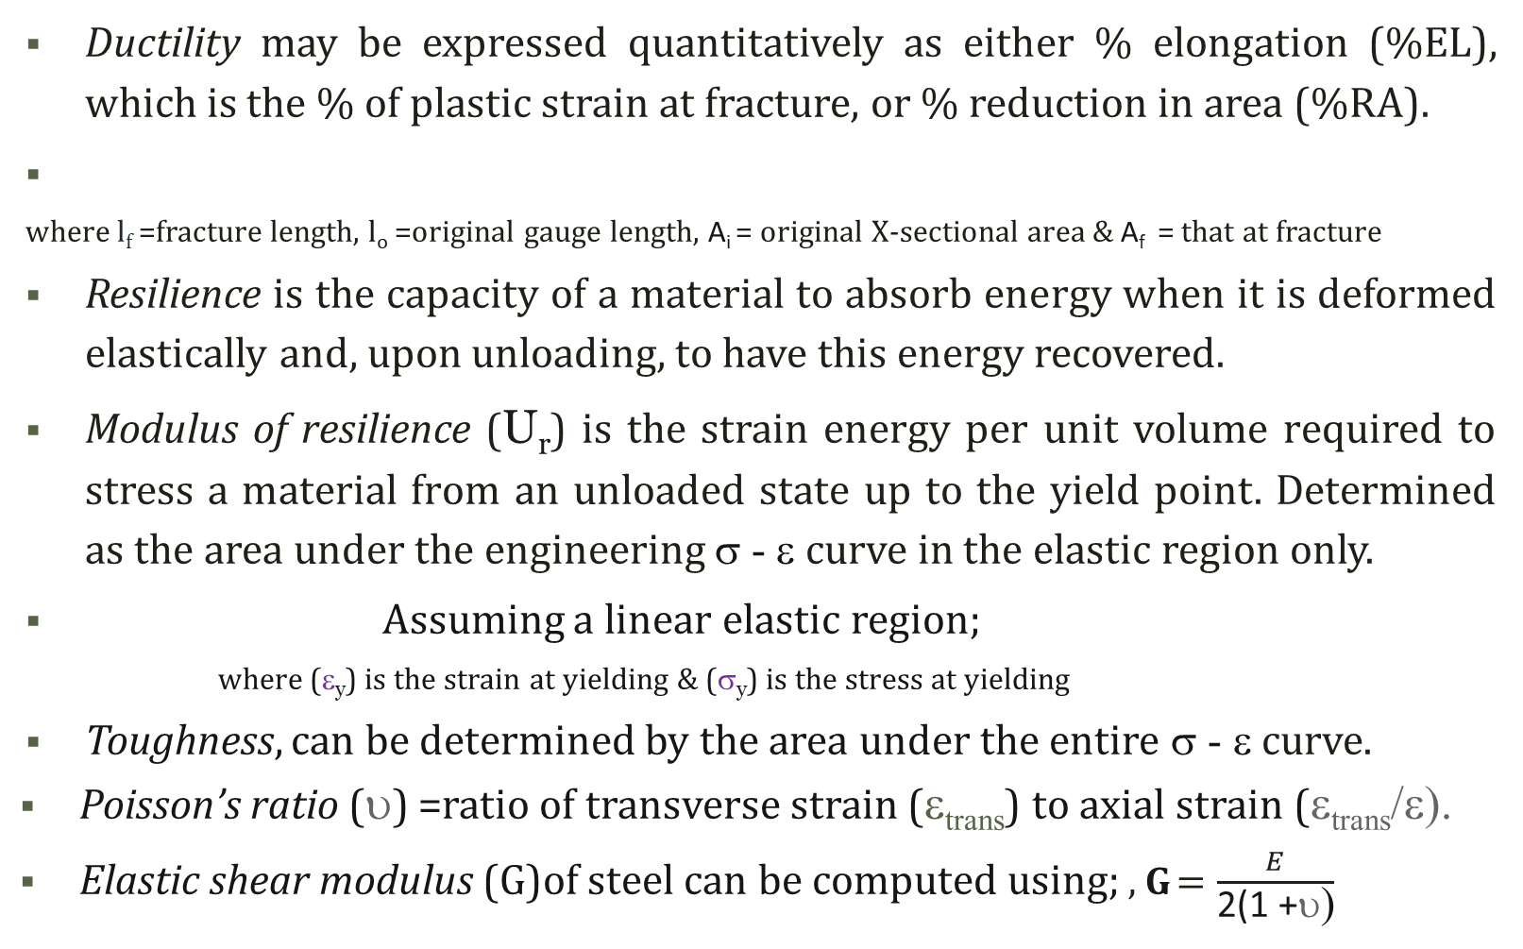
Ductility, Resilience & Toughness from σ - ε curve

Slide 13
Influence of Temperature & Strain Rate on Strength
The movement of dislocations is facilitated by rise in temperature. Thus, both yield and ultimate strengths are reduced as a result.
In structural steels there is a minor loss of strength up to about 300°C. Thereafter there is a progressive loss of strength with increasing temperature.
At 600°C the strength is typically 50% of that at
ambient temperature.
At temperatures above 500°C creep deformation
becomes significant.
Dislocation movement is a time-dependent
process. Thus at high strain rates yielding becomes
more difficult which is reflected in increased yield
stress. Influence of Temperature on strength

Slide 14
Creep & Graphitization in ferrous metals
Creep can be defined as a time-dependent strain occurring under constant stress and is heavily influenced by temperature . There are basically three stages of creep identified— primary, secondary, and tertiary.
For carbon steels, the time-dependent properties dominate the allowable stress above about 400ºC, although creep begins to occur at about 370ºC. Thus the strength of the material drops off rapidly above that temperature.
Graphitization is also a time-dependent microstructural change occurring over a significant period in carbon steels at above 425ºC. The pearlitic microstructure is a mixture of ferrite and cementite. The latter is unstable at higher temperatures and breaks down into pure iron and randomly dispersed carbon (graphite). This can result in a very localized failure of the weak pure iron associated with the brittle carbon.
Often, the primary location for this failure is in the heat-affected zone (HAZ) of a weld at the point where the material is briefly heated above the lower transformation temperature. This occurs slightly away from the fusion line of the weld.

Slide 15
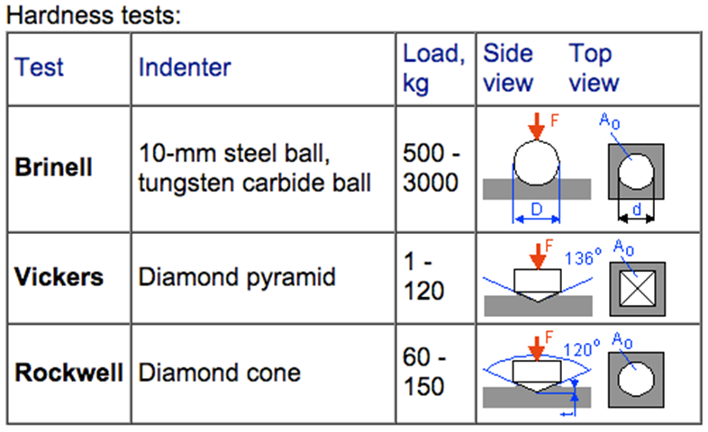
Toughness & Hardness testing
The Toughness of a metal is size dependant (thickness) and 2 main types of toughness tests exist; impact toughness & fracture toughness.
Impact toughness can be determined by, either the Charpy or the Izod test, according to standards such as: BS EN ISO 148-1:2016, EN 10045, ISO 148 for Charpy test and ASTM D256 for Izod. (refer to URL on course page).
Fracture toughness is an indication of the amount of stress required to propagate a pre-existing flaw and can be determined using ASTM E399-08
Macro-hardness tests (Rockwell, Brinell,
Vickers) most widely used for hardness tests.
Micro-hardness tests (micro-Vickers,
Knoop) applicable for hardness of thin
materials or coatings or surface hardness.
Small diamond pyramid is used as indenter
loaded with a small force of 10g to 1000g.

Slide 16
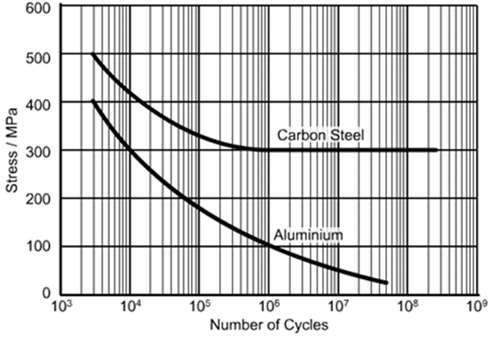
Metal Fatigue & Creep
Fatigue is a form of failure that occurs in structures subjected to dynamic & cyclic stresses (e.g., bridges) whereby failure can occur at a stress level considerably lower than the yield strength.
When a component is stressed there are usually places where the stress is higher than elsewhere maybe due to bad design and/or manufacturing.
At these places cracks tend to form. Each time the stress is applied the crack grows a little longer. Eventually, it exceeds a critical length and the component fails. The higher the stress the fewer stress cycles are needed to lead to failure.
As the number of cycles increases the
tolerable stress decreases. But for steel it is
only up to 300 MPa. whereby it stabilizes
implying that as long as the stress that a steel
element is subjected to is kept below 300
MPa then it would never fail due to fatigue.

Slide 17
Mechanisms for Strengthening of Metals
The strength of a steel can be described as the resistance against the onset of plastic deformation under load. This occurs by the movement of dislocations through the metal lattice. If this motion is hindered by lattice defects, a higher external load must be applied for dislocations to overcome the obstacles. This can be classified into 4 mechanisms;
Solid solution hardening - The increase of strength is produced by foreign atoms which are dissolved in the metal matrix and cause a lattice distortion that hinders the movement of dislocations.(leads to a decrease in toughness).
Strain hardening - Linear lattice defects are the dislocations themselves. The lattice distortion surrounding the dislocation disturbs the movement of other dislocations which increases with increasing dislocation density.
Grain refinement - The grain boundaries are barriers to dislocation motion. As the grain size decreases, the number of barriers increases (strengthens).
Dispersion and precipitation hardening - Strengthening particles are obtained most usually by the precipitation process in the matrix during heat treatment; tempering of quench hardened medium carbon steels.

Slide 18

Classification of Steels - European standard EN10020 (I)
Steel is a material which contains by weight more iron than any other single element and < 2% of Carbon. Table1 showing
(for C > 2 % Cast Irons)
EN10020 classifies Steels according to 2 criteria;
‘Chemical composition’ & ‘main quality classes’
(i) Classification by chemical composition
Non Alloy Steels,
Non of the limit values in Table 1 is reached.
Stainless steels
Cr ≥ 10,5% by weight and C ≤ 1,2% by weight.
Other Alloy Steels
Steels which are not Stainless steels but in which
at least one of the values of Table 1 is reached.

Slide 19
Classification of Steels - European standard EN10020 (II)
(ii) Classification by main quality classes
Steels are classified in accordance to their main characteristics and main application properties into Non Alloy (2), Stainless and Other Alloy Steels (2);
Non alloy quality steels
Steel grades which in general have specified property requirements (e.g.
toughness, grain size control and/or formability) (Non alloy electrical steels : quality steels )
Non alloy special steels
– Higher degree of cleanliness than quality steels
– Specified minimum impact strength (in quenched and tempered condition)
– Specified hardness
– Particularly low contents of P and S (max. 0,020 wt-%) for high quality springs, tyre cord wire, etc.
– Specified minimum impact strength (Charpy-V-notch test) @ -50 °C, > 27 J for test pieces taken in the longitudinal direction or > 16 J for test pieces taken in the transverse direction.
– Steels for nuclear reactor use with specified Cu ≤ 0,10%, Co≤ 0,05%, V≤ 0,05%.
– Specified electrical conductivity > 9 S m/mm2
– Precipitation hardening steels with C≥0,25% + pearlitic-ferritic structure + micro alloyed.
– Prestressing steels.

Slide 20
Classification of Steels - European standard EN10020 (III)
Classification by main quality classes (continued)
Stainless Steels
They are subdivided further according to the following criteria :
Nickel content; Ni < 2,5 wt-% or Ni ≥ 2,5 wt-%.
Main property; Corrosion resisting, or Heat resisting or, Creep resisting.
Other Alloy Quality steels
Alloy quality steels for which requirements exist with regard to toughness, grain size control and/or formability. Not generally intended for quenching and tempering or for surface hardening and which includes:
–. specified minimum yield strength < 380 N/mm2 for thickness 16 mm.
- weldable fine grained structural steels.
– alloy steels for rails, sheet piling and mining frames.
– A.s. for hot or cold rolled flat products for severe cold forming applications(refining) and dual phase steel.
- specified minimum impact strength on Charpy-V-notch test pieces at - 50 °C 27 J (both direction)
- Steels with only Cu-alloying specified & Alloy electrical steels ( improve electrical and magnetic props.)
Other Alloy Special steels: include alloy engineering steels and alloy steels for pressure vessels, bearing steels, tool steels, high-speed steels, and steels with special physical properties such as ferritic-nickel steels with controlled expansion coefficient, or electrical resistance steels.

Slide 21
Designation of Steels according to EN 10027-1:2016
Designations of Non alloy quality steels which shows the application and the mechanical or physical properties of the steels. The configuration consist of 3 groups of symbols, as follows;
Main Symbol: G= casting produced, S = Structural steels or can be P = Steels for pressure vessel construction or, L = Steel for pipe and tubes or, E = Engineering steels or, B = Steel for reinforced concrete or, Y = Prestressing steels or, R = Steels for rails or, H = High Tensile Strength Flat products or, D = Flat Products for Cold Forming or, T = Tinmill Products or, M = Electrical Steel.
nnn = specified minimum yield strength in MPa for the smallest thickness range
For the Additional symbols:‘J2’, ‘K2’, ‘JR’, and ‘JO’ denote the material toughness in relation to the Charpy impact or ‘V’ notch test methodology in Joules and the Test Temperature.
‘W’ is weathering steel (atmospheric corrosion-resistant).
Ex. S 355 J 2 Z15 +M : Structural steel , min. yield strength 355MPa, min. toughness 27J, test temperature -20 degrees C, min.15% striction and thermomechanically formed.
S 355 J 2 G1 W is a weather-resistant structural steel. By adding Cr, Cu and Ni, formed oxide layers stick firmly to the workpiece surface preventing further corrosion of the steel.
For further details please refer to: https://en.wikipedia.org/wiki/Steel_grades
Main symbol | Additional symbols | Additional symbols for steel products
G | S | n | n | n | an……. | +an +an……..

Slide 22
Designation of Steels according to Chemical Composition
Non alloy special steels with Mn contents < 1%
The designation consists of the letter C followed by the mean
% of carbon multiplied by 100 (ex. C45).
Alloy steels with individual alloying element contents
< 5 % and Mn content > 1 %. It starts with the mean carbon %
multiplied by 100, followed by the chemical symbols of the
alloying elements, ordered in a decreasing % and factored
according to values in the Table above (ex. 10CrMo9-10).
For Alloy steels with individual alloying element ≥ 5 %.
It starts with the letter X followed by the same designation
as low alloy steel but the % of alloying elements is
unfactored (ex. X10CrNi18-10).
High-speed steels are designated with the letter HS
followed by the % of alloying elements always maintained
in the following order: tungsten (W), molybdenum(Mo),
vanadium (V) and finally cobalt (Co) (ex. HS 2-9-1-8).

Slide 23
Classification of Stainless Steels
Ferritic Stainless Steel: Ferritic steels are iron-chromium alloys with body-centered cubic crystal structures (BCC). These are generally magnetic and cannot be hardened by heat treatment, but can be strengthened by cold working.
Austenitic Stainless Steel: Austenitic steels are the most corrosion-resistant. It is non-magnetic and cannot be heat-treated. Austenitic steels, in general, are very weldable.
Martensitic Stainless Steel: Martensitic stainless steels are extremely tough and strong, but they are not as corrosion-resistant as the other two above classes. These steels are machinable, magnetic, and heat treatable.
Duplex (Dual Phase) Stainless Steels: Duplex stainless steel has a two-phase microstructure made up of ferritic and austenitic stainless steel grains. Duplex steels have approximately twice the strength of austenitic or ferritic stainless steels.
Precipitation-Hardening (PH) Stainless Steels: Due to precipitation hardening, PH stainless steels have extremely high strength.

Slide 24
Delivery Conditions of Steel products
The supply condition of the product is very important with respect to the application of the steel and should be clearly stated in the order, such as:
As-rolled steel - Steel cools as it is rolled, with a typical rolling finish temperature of around 750°C. Steel that is then allowed to cool naturally is termed 'as-rolled' material.
Normalized steel - Normalizing takes place when as-rolled material is heated back up to approx. 900°C, and held at that temperature for a specific time, before being allowed to cool naturally. This process refines the grain size and improves the mechanical properties, specifically toughness.
Normalized-rolled is a process where the temperature is above 900°C after rolling is completed. This has a similar effect as normalizing, but it eliminates the extra process of reheating the material. Normalized and normalized-rolled steels have an 'N' designation.
Thermomechanically rolled (TMR) steel utilises a particular chemistry of the steel to permit a lower rolling finish temperature of around 700°C. Greater force is required to roll the steel at these lower temperatures, and the properties are retained unless reheated above 650°C. Thermomechanically rolled steel has an 'M' designation.
The process for Quenched and Tempered steel starts with a normalized material at 900°C. It is rapidly cooled or 'quenched' to produce steel with high strength and hardness, but low toughness. The toughness is restored by reheating it to 600°C, maintaining the temperature for a specific time, and then allowing it to cool naturally (Tempering). Quenched and tempered steels have a 'Q' designation.

Slide 25
THANK YOU

