Slide 1


Unit 7 – Corporate Finance

Slide 2

Corporate Finance
The financial structure of a company is not static and evolves over time due to changing business needs and fluctuating financing costs. Privately held companies also adapt their financing structures in response to shareholder requirements.
The capital a company needs often aligns with its operational demands. For instance, if a company intends to expand its business but lacks the funds for necessary equipment, it must find financing for the machinery.
This Photo by Unknown Author is licensed under CC BY-SA

Slide 3

Corporate Finance
The varying costs of different financing options heavily influence the chosen approach for obtaining funds. Profit-focused companies aim to maximize profits while minimizing expenses, resulting in shifts in financing structure.
If all other factors remain constant, changes occur when one financing type becomes more cost-effective than another.
This Photo by Unknown Author is licensed under CC BY-SA

Slide 4
Corporate Finance
Businesses seeking investments primarily approach investors or lenders. Opting between equity and debt financing can be complex. Numerous funding methods are available, with equity and debt financing being the main avenues.
Equity financing involves distributing company shares to investors who contribute financially. Capital infusion can originate from existing shareholders or external investors purchasing shares. Debt financing, the second option, entails securing standard loans from domestic or international banks or issuing debentures, often requiring collateral to guarantee repayment.

Slide 5
Corporate Finance
Equity holders receive dividends as returns for their investment, while debenture holders or creditors (for loans) receive interest. This distinction stems from equity holders' ownership status.
Choosing between equity and debt financing is crucial, depending on risk tolerance, business nature, and management approach. Although both methods enhance capital utilization, making the wrong choice could lead to financial troubles jeopardizing the company's viability.

Slide 6

SHARES
Companies seeking financing through share issuance have the option of presenting potential investors with various categories of shares. The rights associated with each share category are detailed in the terms of issuance, and companies issuing shares can limit these rights within the company's constitution.
Investor shareholders possess the ability to transfer and sell their share holdings according to their convenience (Section 49 of the Companies Act 2001). In addition to potential capital gains, investors receive dividends from their share ownership. Nevertheless, the distribution of dividends to shareholders is subject to approval by the company's board of directors (Section 63 of the Companies Act 2001).
This Photo by Unknown Author is licensed under CC BY

Slide 7
SHARES
Dividends are paid to shareholders using the company's retained earnings. The board of directors has the authority to withhold dividend distribution in a given year if it deems this to be in the company's best interests, for instance, if the company has plans for diversification or expansion. Ordinary shareholders, including investors, don't have a guaranteed annual return, especially since distribution can occur only if the company generates profits.
Alternatively, investors can opt for different share classes that guarantee a fixed cumulative return on their investment. To attract investors, the company seeking funds will design terms for share issuance. The company might opt to issue redeemable shares, enabling it to repurchase shares from investors at its discretion on a predetermined date specified in the terms of issuance, and at a pre-agreed price.

Slide 8

STOCK MARKET
Once public companies attain a specific level of growth, they might decide to list their shares on the official market of the SEM (Stock Exchange of Mauritius) to gather capital from the general public. Listing on the SEM brings along several obligations related to adherence to the SEM Listing Rules and the National Code of Corporate Governance 2016.
The advantage of obtaining a listing on a securities exchange is that it tends to appeal to investors, who are more inclined to invest in a market that is open and transparent, and where transactions are conducted in accordance with rigorous compliance regulations.
This Photo by Unknown Author is licensed under CC BY-SA-NC

Slide 9
DEBENTURES
An alternative method for companies to raise capital is through the issuance of debentures. The term "debenture" is defined in Section 2 of the Companies Act 2001 as follows:
"A debenture is a written acknowledgment of indebtedness issued by a company in relation to a loan that has been extended or is intended to be extended to the company or another individual, or concerning funds that have been deposited or are planned to be deposited with the company or another individual, or the existing debt of the company or another individual, whether this establishes a charge on any of the company's assets or not.

Slide 10
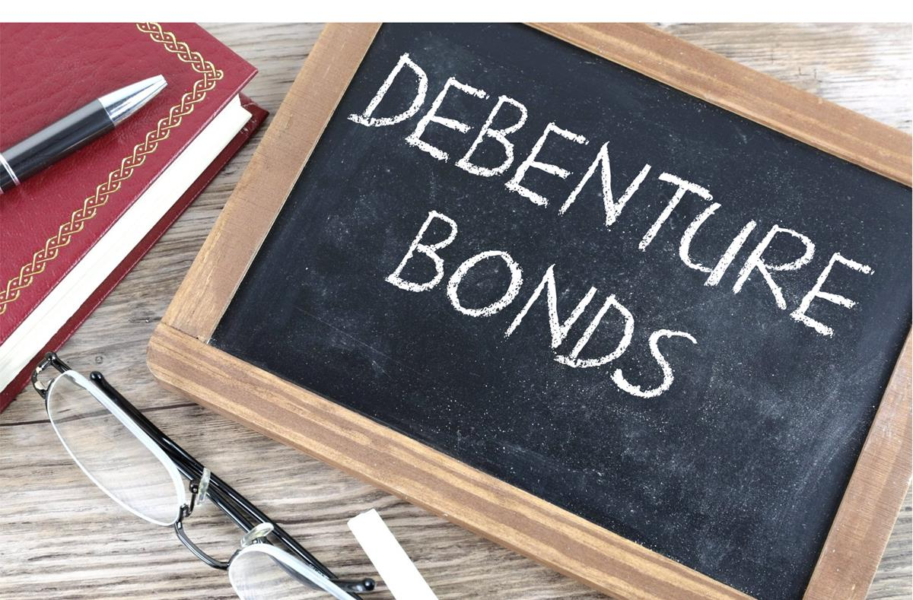
DEBENTURES
This definition includes:
debenture stock;
convertible debenture;
a bond or an obligation;
loan stock;
an unsecured note; or
any other instrument executed, authenticated, issued, or created in consideration of such a loan or existing debt."
This Photo by Unknown Author is licensed under CC BY-SA

Slide 11
DEBENTURES
However, the definition does not encompass:
a bill of exchange;
a promissory note;
a letter of credit;
an acknowledgment of indebtedness issued in the regular course of business for goods or services provided;
a policy of insurance; or
a deposit certificate, passbook, or similar document linked to a deposit or current account at a banking company.

Slide 12
DEBENTURES
Debentures are classified as securities and can thus be traded on the Stock Exchange. Companies have the flexibility to issue various classes of debentures, each with distinct repayment terms, optional security provisions, redemption features, varying interest rates, and the choice of converting debentures into shares. The company has the authority to define the rights attached to each class of debentures to attract the needed capital.
It is mandatory for the company to maintain a register of debenture holders at its registered office, as stipulated in Section 124 of the Companies Act 2001. This register must contain the names and addresses of debenture holders along with the amount of debentures they hold. Any debenture holder or shareholder of the company has the right to inspect this register.

Slide 13
CONVERTIBLE DEBENTURES
The company has the option to issue debentures that are convertible, meaning they can be converted into shares at a future point.
The company will define the conversion date when these debentures can be transformed into shares.
Specific details such as the portion of the shares' value considered as already paid, as well as the conditions for debenture holders to exercise their right to subscribe for shares instead of holding the debentures, will also be stipulated by the company.

Slide 14

DEBT FINANCING
Debt financing comes into play when a company establishes an agreement to borrow funds from an external party, typically a bank, that provides the required capital. The cost of borrowing is typically reflected in the interest charged on the borrowed amount, and these interest payments are considered deductible business expenses, which the company can offset for tax purposes.
Lenders fall under the category of creditors and are commonly referred to as 'financial creditors' to differentiate them from other creditors to whom the company owes money. Unlike other creditors, even if the lending of money isn't the primary focus of a financial creditor's activities, it still represents the main objective of the financial creditor's transaction with the company.
This Photo by Unknown Author is licensed under CC BY

Slide 15

LOANS
Financial entities like banks receive deposits and utilize these deposits to extend loans and advances to both businesses and individuals, or to fund authorized endeavors sanctioned by the Bank of Mauritius.
To facilitate loans, advances, or other credit facilities, financial institutions necessitate collateral. This collateral can take various forms such as mortgages, fixed and floating charges, share pledges, and other types of acceptable payment assurances as outlined in applicable laws and regulations.
This Photo by Unknown Author is licensed under CC BY

Slide 16

CONVENTIONAL FORM OF COMPANY FINANCING
The prevalent method of obtaining debt financing for Mauritian companies is primarily achieved through bank loans. In Mauritius, a handful of commercial banks present enticing interest rates and additional provisions tailored to support corporate financing, particularly catering to Small and Medium Enterprises.
Typically, securing a loan from banks necessitates the provision of at least one type of security or assurance. The principal categories of securities frequently demanded by local banks will be explored in the subsequent discussion.
This Photo by Unknown Author is licensed under CC BY

Slide 17
FIXED AND FLOATING CHARGES
Fixed and floating charges, also referred to as "sûreté fixe" and "sûreté flottante," find their basis in the Mauritian Civil Code (Chapter Ten – Article 2202 et seq. Mauritian Civil Code) and are rooted in French legal principles.
The creation of a fixed or floating charge on a property is only permissible in favor of an "institution agréee" listed under Article 2202-2 of the Mauritian Civil Code and the Institutions Agréees Regulations 1988. Examples of such "institutions agréees" encompass:

Slide 18

FIXED AND FLOATING CHARGES
The Government of Mauritius
Banks established under the Banking Act
Insurance companies
Companies incorporated and registered under the Companies Act or any body licensed by the FSC as a Category 1
Bank of Mauritius
DBM Ltd
Employees Welfare Fund, etc.
This Photo by Unknown Author is licensed under CC BY-SA

Slide 19
FIXED AND FLOATING CHARGES
In Atelier Etude Limousin & Ors v. BPCE International Et Outre Mer & Anor [2014 SCJ 166], the Supreme Court of Mauritius clarified that any institution or "tout organisme de financement," whether local or foreign, recognized by the Minister of Finance under the regulation, is considered an "institutions agréee.“
Consequently, a corporate entity not registered in Mauritius and without a place of business therein is deemed an "institutions agréee," enabling the creation of a fixed or floating charge.

Slide 20
FIXED AND FLOATING CHARGES
A fixed charge is a security that encumbers the entirety of the debtor's property, whether movable or immovable, and grants a "droit de preference" (Article 2202-53 Mauritian Civil Code) and a "droit de suite" (Article 2202-17 Mauritian Civil Code) over said property.
The "droit de preference" affords the creditor, such as a bank extending a loan to a company, priority over other creditors ("creanciers chirographaires") in case of the company's insolvency or winding up. The debtor cannot sell the property subject to a fixed charge without prior written authorization from the lending institution (Article 2202-29 Mauritian Civil Code).

Slide 21
FIXED AND FLOATING CHARGES
Conversely, the "droit de suite" empowers the creditor to seize the encumbered property, even if it has been transferred to a third party by the debtor. The fixed charge permits the lending institution to sell the seized property according to the Sale of Immoveable Property Act.
A floating charge is akin to a fixed charge, but it burdens both the current and future property of the debtor until crystallization of the charge (Article 2202-38 Mauritian Civil Code). Crystallization immobilizes all property in the debtor's "patrimoine," converting the floating charge into a fixed charge (Article 2202-40 Mauritian Civil Code). Typically, crystallization occurs when a winding-up petition is presented against the debtor company or upon a winding-up resolution for company liquidation.

Slide 22
FIXED AND FLOATING CHARGES
For both fixed and floating charges to be effective during the repayment period, they must be registered with the Conservator of Mortgages. Registration lasts for 40 years and requires renewal before the expiration, or the charge loses priority. The register of charges held by the Conservator of Mortgages is publicly accessible.
In the case of Damree Bibi Yasmeen v. Mauritius Commercial Bank [2004 SCJ 209], the Supreme Court of Mauritius ruled that failure to renew registration results in a fresh inscription of the charge, affecting the ranking of privileges.

Slide 23

DEFAULT OF PAYMENT – SECURED LENDING
Large-scale loans are seldom granted by banks to companies without any collateral provided. Consider a basic loan agreement without collateral and contemplate the bank's options if the company fails to fulfil its payment obligations, essentially defaulting on interest, repayment of the borrowed sum (principal), or any instalments. Beyond sending payment demands or renegotiating the loan terms, the bank might:
Initiate legal action against the company to retrieve the amount due according to the loan agreement, pursuing enforcement of the court decision. If the execution of the judgment debt is unsuccessful, the bank could request court intervention to liquidate the company.
This Photo by Unknown Author is licensed under CC BY

Slide 24
DEFAULT OF PAYMENT – SECURED LENDING
Issue a statutory demand for payment (when the debt surpasses MUR 250,000). If the company neglects to settle the debt, the bank can petition the court for the company's liquidation.
When a company is unable to meet its financial obligations as they become due, it's considered insolvent. Unless the company has a realistic chance to secure additional funds to address its debts and navigate its way out of insolvency, it's likely to undergo insolvency proceedings.
This entails the company's liquidation, where its assets are distributed among its creditors. Once insolvency liquidation begins, creditors are barred from pursuing legal actions to recover owed debts, relying instead on the liquidator to allocate the company's assets fairly among them (refer to Chapters 9 and 10 on Insolvency for more details).

Slide 25

DEFAULT OF PAYMENT – UNSECURED LENDING
When a loan lacks collateral, the lender's recourse is confined to contractual rights against the company. If the company becomes bankrupt and enters liquidation, the lender forfeits the ability to enforce the contract. An unsecured lender, in this context, hasn't secured any property rights.
This means they lack the authority to seize designated valuable assets owned by the company in case of loan repayment default. Essentially, an unsecured lender lacks the privilege to appropriate valuable company property if the loan is unpaid.
This Photo by Unknown Author is licensed under CC BY

Slide 26
DEFAULT OF PAYMENT – UNSECURED LENDING
The distinction between secured and unsecured lending is pivotal due to the substantial legal safeguards afforded to secured lenders. This point holds paramount significance. Within secured lending, a critical differentiation is established between fixed charge security and floating charge security.
Legally, a lender securing its loan with a floating charge against company property finds its property rights relegated below certain other debts (preferential debts), liquidator expenditures, and statutory charges. This holds true even when the lender secures the loan via a floating charge. In comparison to the well-defined and robust property rights of fixed charge holders, those of floating charge holders are comparatively less established.
During the phase of insolvency liquidation, it's crucial to scrutinize the rights of distinct secured lender categories, primarily fixed and floating charge holders.

Slide 27

EQUITY FINANCING
When a corporation acquires funds through equity financing, it releases shares to one or multiple investors, who then become part of the company's membership and are known as "shareholders."
These shareholders are accountable for remitting the initial buying cost of the shares to the company in exchange for ownership.
This arrangement proves beneficial for both parties: the company secures the necessary funds, while the shareholder acquires a valuable asset in the form of company shares. By acquiring shares, the shareholder contributes 'equity capital' to the company, which is synonymous with 'share capital' in legal terms.
This Photo by Unknown Author is licensed under CC BY

Slide 28
EQUITY FINANCING
Only publicly traded entities, not privately held ones, are authorized to offer shares to the general public. Any company planning to conduct a public offering must adhere to stringent legal regulations outlined in securities law. While offering shares to be listed on a stock exchange is the most apparent illustration of a public offering (and the sole case requiring a prospectus), securities regulation extends beyond this type of company's public offering.
The sum of dividends disbursed to shareholders within a fiscal year represents the cost of equity financing for the company during that period. This is akin to the annual interest paid on a loan, signifying the cost of debt financing. Due to the legal framework surrounding equity financing, the process of "servicing" or making payments is notably more adaptable compared to debt financing. This flexibility is particularly crucial during challenging economic conditions, underscoring the greater versatility of equity financing over debt financing.

Slide 29

HYBRID FINANCING
Differentiating between equity finance and debt finance holds paramount importance within the legal framework, for tax considerations, and in financing practices.
While there exist numerous laws governing the interactions between a company and its shareholders compared to those between a company and its creditors, both relationships are fundamentally contractual.
Substantial room exists for the company and a financier, whether a lender or a potential shareholder, to establish mutual terms for their transactions.
This Photo by Unknown Author is licensed under CC BY-SA

Slide 30
HYBRID FINANCING
This holds particularly true when a company offers multiple types of shares to potential investors. Even though certain provisions of company law are applicable across all share classes, such as the dividend prohibition without distributable profits or the creditor priority in winding up, other legal prerequisites can be fulfilled by a single class of shares. Consequently, establishing subsequent share classes can occur with fewer legal restrictions. Consider the following illustrations:
Companies can introduce non-voting share classes if they already have a voting share class engaged in business decisions.
A company can restrict return of capital rights for holders of one or several other share classes, provided at least one class has entitlement to surplus assets in case of winding up.
Once a company has a non-redeemable share class, it can freely create additional classes of redeemable shares in the future.

Slide 31
HYBRID FINANCING
The need for adaptability on both sides has fostered an array of financial arrangements between businesses and capital providers, leading to diverse financing structures that may not straightforwardly align with the "equity" or "debt" categories. Such flexible financing often results in complex legal arrangements exhibiting characteristics of both equity and debt.
This type of financing is sometimes labelled as "hybrid" financing, encompassing shares resembling debt and debt taking on equity-like attributes. One example of equity financing akin to debt is preference shares. Preference shares can embody certain debt characteristics.
A convertible loan stock exemplifies a debt instrument that can, at the holder's discretion, transform into ordinary shares, effectively transitioning into equity financing. This conversion generally adheres to predetermined terms, including a conversion price, date, or specific triggering event. Convertible loan stock may also be termed convertible debt stock.

Slide 32
THANK YOU
This presentation is made available to you with a licence.

