Slide 1
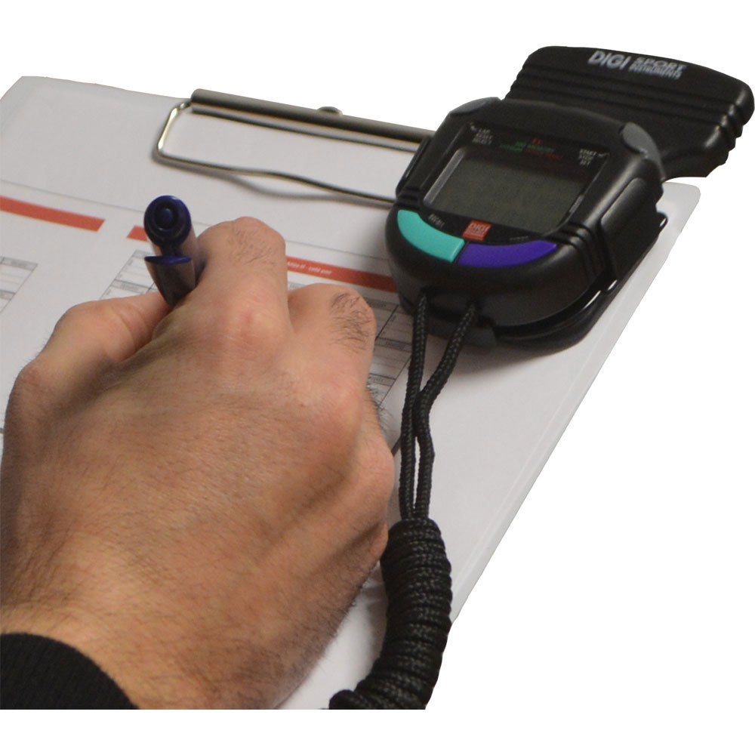
MEASUREMENT, AND EVALUATION IN SPORTS TRAINING, COACHING AND EXERCISE
Mr Nagaissen Valaydum
&
Mr Hemant Buldawo

Slide 2
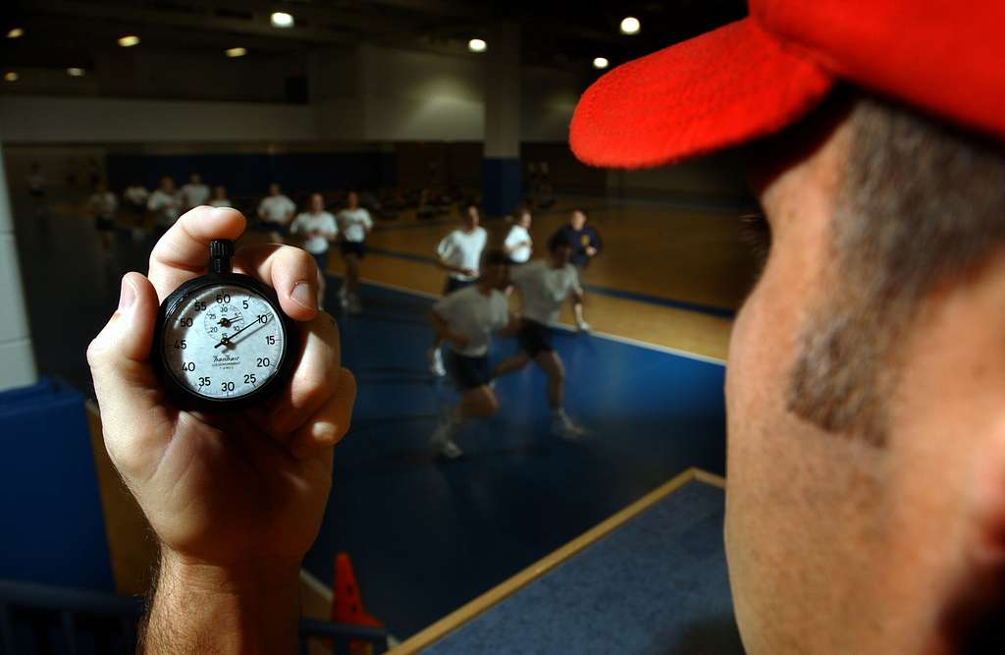
Table Of Content
1. Introduction
2. Definitions
3. Importance And Objectives
4. Criteria of Test Selection.
5. Guidelines For Test
Administration
6. Conclusion
7. References

Slide 3
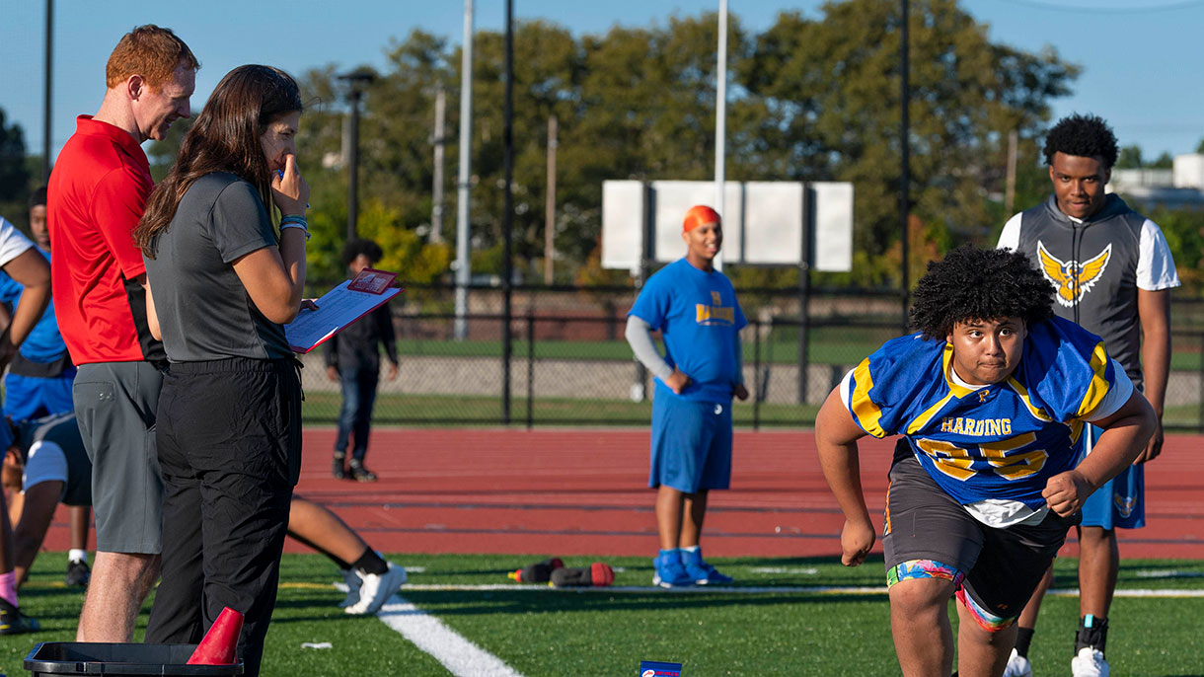
Introduction
Successful training program
The aim of fitness testing is to measure and evaluate specific health or skills related fitness components

Slide 4
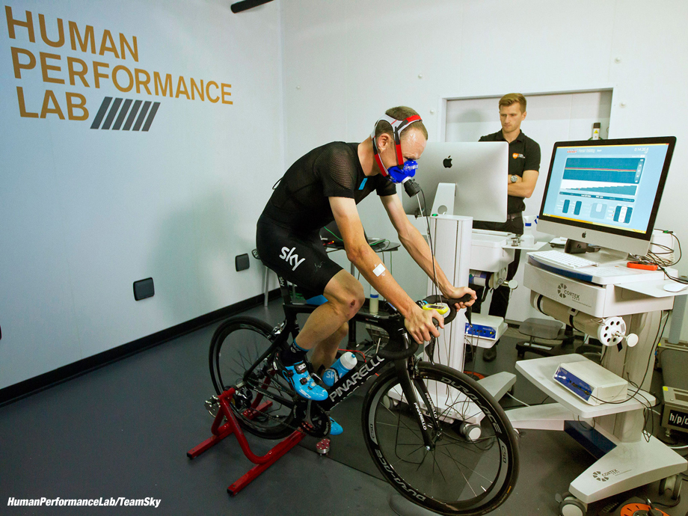
Definition of Test
Test is a tool to evaluate the skill, knowledge, capacities or aptitudes of an individual or a group. – Webster’s Dictionary
Test is the form of questioning or measuring used to access retention of knowledge, capacity or ability of some endeavour. – Barry L Johnson and Jack Nelson
A Test is an instrument or a standard procedure.
Each types of test have different aims.
At the end of the test - Results

Slide 5
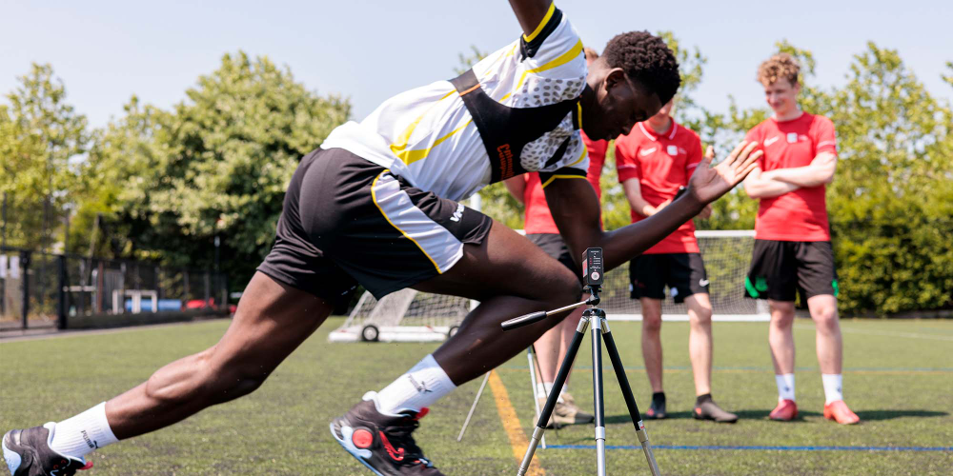
Definition of Measurement
Measurement is the use of tests and techniques to collect information or data about a specific skill or fitness level of an individual.
Scores obtained through tests and are used in the evaluation process.
Measurement refers to the process of administrating a test to obtain quantitative data. – H M Barrow
Measurement aids evaluation process in which various tools and techniques are used in collection of data. – Barry L Johnson and Jack Nelson
“Measurement is an act or process that involves the assignment of numeric values to whatever is being tested. So it involves the quantity of something.” - R.N.Patel

Slide 6
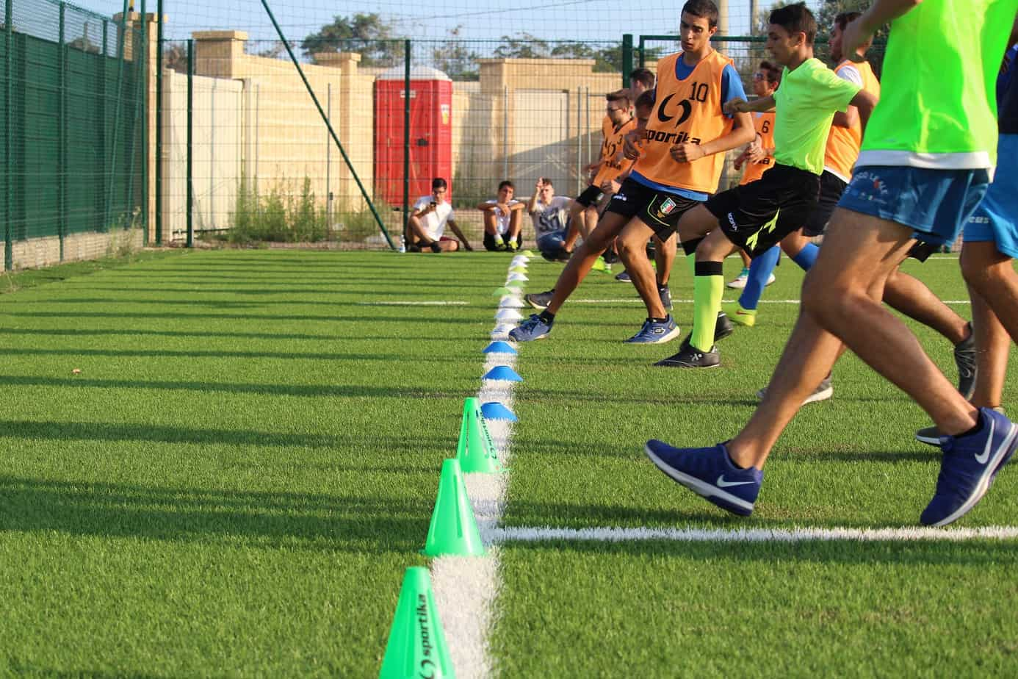
Definition of Evaluation
Evaluation is a decision making process
Questions!
Why is test, measurement and evaluation in sports training important?
“Evaluation is the process of education that involves collection of data from the products which can be used for comparison with preconceived criteria to make judgement.” – H M Barrow and Megee
“Evaluation is the process of interpreting analyzing and assessing the data obtained from tests evaluation can be either subjective or objective it is the judgment of what the numerical measurement data actually mean” - Hopkins and Stanley

Slide 7
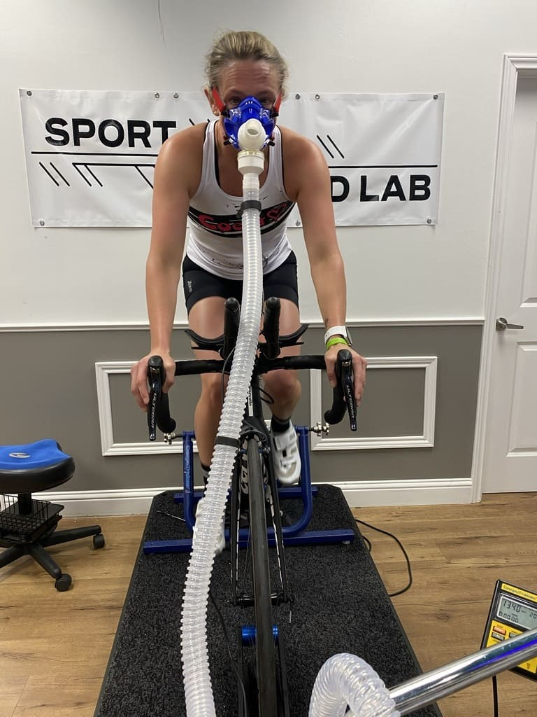
Importance of Test, Measurement & Evaluation in Sports
The importance of test, measurement and evaluation in sports can be classified in three different groups that is, from:
The Coach/Teacher’s perspective and
An athlete/individual’s perspective
The training programme’s perspective.

Slide 8
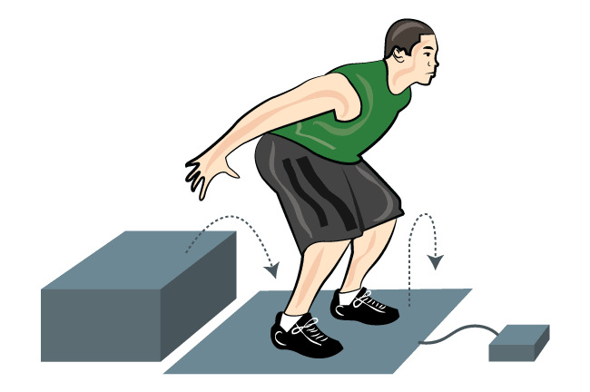



Importance of Test, Measurement and Evaluation from athlete’s perspective
Self-Appraisal of performance
Motivation of athletes for continuity
Goal setting for performance enhancement

Slide 9
Diagnosis Of Problems And Errors In Teaching-Learning Process
Grouping Of Athletes As Per Ability or Skill
Self-Assessment Of Teaching Effectiveness
Prediction Of Performance Of Athletes
Importance of Test, Measurement and Evaluation from coach/trainer’s perspective

Slide 10




Comparison of training programme with desired objectives and outcomes of athletes.
Norms and Standards can be established
Importance of Test, Measurement and Evaluation from the
Training Programme’S perspective
Re-designing of programme based on previous test results
Provides Quality Check and control process of training system and athlete development programmes.

Slide 11




Criteria for test selection
2. Administrative Feasibility
1. Scientific Authenticity
3. Educational Application
The selection of the test should be in line with the objectives.

Slide 12
Equipment
1. Scientific Authenticity
Instruments
Number of trials
Test instructions
(a)Reliability: -
A test is reliable if we can depend on it, it must have been tested and approved scientifically.
The following factors affect the test reliability:

Slide 13
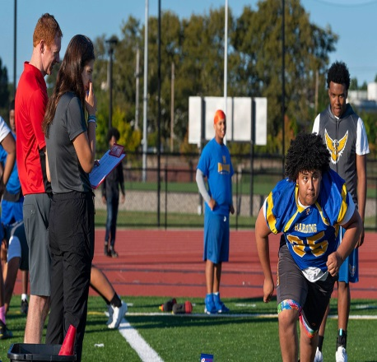


Specific :The test must be appropriate to assess an athlete’s particular health or skill related fitness component
Objectivity : objectivity is increased by clean test direction and Precise scoring methods
Criteria for test selection
Validity :The tests must have been approved scientifically and
A test is valid if it is measuring, as accurately as possible about what it is supposed to measure.
Norms : A norm is a scale that allows the conversion of numeric data into a score, capable of comparisons and interpretations of the result.

Slide 14
Equipment: all the equipment needed for the test should be available and inexpensive
Time : the test should be less time consuming
Utility: at the end of the test the data collected should be usable.
Money: It should be economical, based upon a prescribed budget
Administrative Feasibility

Slide 15
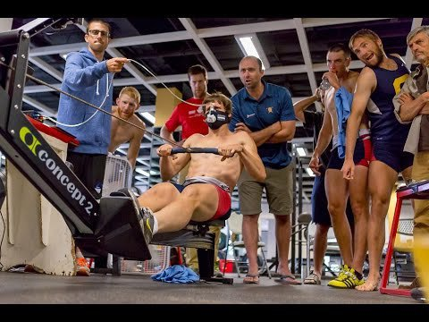
Education Application:
The test must contribute to the educational development of the participant, develop positive attitudes and mind sets.
They must take the test as a learning opportunity, to create a better version of one from their own past mistakes.

Slide 16

Guidelines for test administration
Administration of the test involves
1.organization,
2.management,
3.execution,
4.supervision of the tests,
5.utilization of test results and
6.Proper follow-up.
The administration process of a test may be divided into three parts:
1.Pre- planning
2.Testing Operation
3.Post- Test Function

Slide 17
A test planning document must be prepared. There must be a plan for conducting the test.
Testing stations, score sheets, questionnaire, organization of group, test layout etc. must be prepared before the testing.
Information - information regarding testing purpose, scientific authenticity of test, group size, age, sex must be considered well in advance.
The test must be planned in such a way that it is economical in terms of cost of instrument/equipment, economy of time and number of personnel required.
Pre- Planning

Slide 18
All the equipment and facilities needed for the test must be checked and placed in proper position before the arrival of the participants.
Before starting the test, a short warm-up is required to avoid injury and assure better performance.
The coach and testing personnel must ensure safety precautions during explanation, demonstration and during the testing phase.
The coach should cross check with all the necessary points from his check list.
All instructions, explanation, demonstration, layout plan illustration should be given to the participants before the start of the test.
Testing Operation
Motivation strategies should be adopted for the participants to perform best during the test.

Slide 19
All questionnaires and score sheets must be complied in a safe place and raw data collected should be converted into standard scores to compared with norms.
Test scores must be interpreted as per standards and norms by applying appropriate statistics.
To illustrate the results, appropriate tables, graphs and profile may be prepared.
A report should be prepared after the event which indicates the nature, scope and objectives of the testing programme.
Post-Test Functions

Slide 20

CONCLUSION
The coach who is carrying out the evaluation process must have the required skills. Every coach or a physical education teacher must always remember about the aims and objectives associated with the evaluation process so as, to get all the required data, through various tests and measurements that will be conducted, to help in decision making process.

Slide 21


Slide 22
References
Yobu.a (2010).Test, Measurement and Evaluation in Physical Education and Sports. Friends Publications, New Delhi
Kansal, D.K.(2008).Textbook of Applied Measurement Evaluation and Sports Selection. Sports and Spiritual Science Publication, New Delhi.
Barrow, H. M., & McGee, R. (2000). Barrow and McGee’s Practical Measurement and Assessment. Lippincott Williams and Wilkins
Mathew, Donald K. Measurement in Physical Education (London: W.B Standers Co.
Clarke H. David and Clarke Harrison H. Application of Measurement to physical Education (Englewood Cliffs: Prentice Hall. Inc)
Webster’s Dictionary, https://www.merriam-webster.com/dictionary/test

Slide 23
Picture References
slide 1 picture https://www.tradeinn.com/runnerinn/en/digi-sport-instruments-dtm60el-stopwatch/140671172/p
Slide 2 picture https://picryl.com/media/an-instructor-in-the-freedom-hall-athletic-complex-uses-a-stopwatch-while-recruits-3a3586
Slide 3 picture https://www.sacredheart.edu/offices--departments-directory/pioneer-performance-center/services--pricing/
Slide 4 picture https://pezcyclingnews.com/toolbox/toolbox-froomes-lab-testing/
Slide 5 picture https://www.staffs.ac.uk/course/sport-exercise-science-bsc slide 6 picture https://www.scienceforsport.com/4-essential-tips-for-administering-fitness-testing/
Slide 7 picture https://sportspeedlab.com/performance-testing/
Slide 8 pictures https://breakingmuscle.com/the-science-and-psychology-of-motivation-for-athletes/ https://www.dummies.com/article/business-careers-money/careers/general-careers/goal-setting-categorize-and-prioritize-your-life-goals-262814/ https://breakingmuscle.com/the-science-and-psychology-of-motivation-for-athletes/ https://simplifaster.com/articles/mental-skills-athlete-motivation/ slide 10 pictures https://liftvault.com/programs/strength/ https://mailshake.com/blog/sales-training-programs/ https://klaxoon.com/community-content/the-training-program https://uknowva.com/blogs/employee-training-program
Slide 11 pictures https://unctad.org/topic/science-technology-and-innovation/young-scientist-phd-programme https://www.lynn.edu/academics/areas-of-study/sports-management-mba https://acpe.edu.au/courses/bachelor-of-sports-coaching-management/ slide 15 picture https://www.quora.com/What-do-you-mean-by-the-importance-of-test-measurement-and-evaluation-in-sports slide 20 picture https://www.verywellfit.com/what-a-fitness-test-can-tell-you-about-your-health-3120283

