Slide 1

Principles of Management
Unit 9
Motivation Process
N K BETCHOO

Slide 2
The Motivation Process
Motivation is defined as the willingness to exert high levels of effort to reach organisational goals. It is conditioned by the effort’s ability to satisfy some individual need. The three key elements in the definition of motivation are: effort, organisational goals and needs.
Unsatisfied Need
Tension
Drive
Search Behaviour
Fulfil need
Motivation Achieved

Slide 3
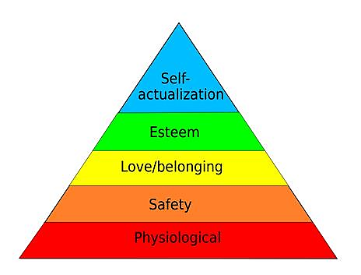
Maslow’s Hierarchy of Needs
Physiological

Slide 4
Maslow’s Hierarchy of Needs
Physiological needs: These refer to food, drink, shelter, sexual satisfaction, and other bodily requirements. It is considered as the lowest order need.
Safety needs: A person’s needs for security, protection from physical and emotional harm. This is a level above the physiological need.
Social needs: A person’s needs for affection, belongingness, acceptance and friendship. As an individual, one needs friendship.

Slide 5
Maslow’s Hierarchy of Needs
Esteem needs: Internal factors such as self-respect, autonomy and achievement; and external factors such as recognition and attention. This is a higher order need.
Self-actualising needs: A person’s drive to become what he or she is capable of becoming.
It is the highest order need and it also creates self-satisfaction and fulfillment on the part of the individual.

Slide 6
Mc Gregor’s Theory X and Y
Mc Gregor proposed two distinct views of the human beings: a basically negative view called Theory X and a basically positive view called Theory Y.
Under Theory X, the assumptions are:
Employees inherently dislike work, and wherever possible try to avoid it.
Employees dislike work, therefore they should be coerced, controlled and threatened.
Employees will shirk responsibilities and seek formal direction.
Most workers place security above all other factors at work.

Slide 7
Mc Gregor’s Theory X and Y
Under Theory Y:
Employees view work as being natural as rest or play.
Employees will exercise self-direction and self-control.
The average person will accept to seek responsibility.
The ability to make good decisions is widely dispersed throughout the population.

Slide 8
Mc Clelland’s Three Needs Theory
David McClelland proposed the Three Needs theory. There are three major relevant motives or needs in work situations.
The need for achievement (nACh): The drive to excel, to achieve in relation to a set of standards, to strive to succeed.
The need for power (nPow): the need to make others behave in a way that they would not have behaved otherwise.
The need for affiliation (nAff): The desire for friendly and close interpersonal relationships.

Slide 9
Expectancy Theory
The core theory relates to three variables:
Effort, performance and reward.
The strength of particular outputs or rewards for an individual is termed valence.
The probability that a valence will produce an outcome is called ‘expectancy’.
Valences and expectancies depend on the individual’s own perception of a situation.

Slide 10
Expectancy Theory
Expectancy that good effort leads to good performance
Extrinsic
Expectancy that good performance leads to rewards
Effort
Performance
Reward
Expectancy that rewards asare attractive
Intrinsic

Slide 11
Expectancy Theory
The main features of the expectancy theory are:
It takes a comprehensive view of the motivation process.
It shows individuals’ dependency on outcomes.
It focuses on the importance of individual perceptions of the reality.
It implies that job satisfaction follows effective job performance rather the other way round.
It has led to the development of job re-design.

Slide 12
Expectancy Theory
An individual’s perception of rewards is a vital part of the theory.
These rewards may be intrinsic or extrinsic.
Intrinsic rewards are those derived from self-fulfilment, esteem and personal growth.
Extrinsic rewards are those provided by the organisation like pay, promotion and good working conditions; factors over which the individual has no control.

