Slide 1

Metallic and Polymeric Materials for Civil Engineering
Unit 4 – Corrosion Mechanisms & Corrosion Control for Ferrous metals
Unit Tutor: Dr. Roodheer BEEHARRY
Civil & Environmental Engineering Department

Slide 2
Content
Metallic Corrosion - a Major Issue Worldwide
Types of Corrosion
Electrochemical (Single Metal) corrosion or Wet corrosion
Galvanic Cell or Composition Cell Corrosion
Differential Aeration or Concentration Cell corrosion
Chemical corrosion or Dry corrosion
Microbiologically Influenced Corrosion (MIC)
Corrosion under stress
Forms of corrosion
Corrosion thermodynamics
Electrochemical kinetics of corrosion
The Rate of metallic corrosion
Pourbaix Diagram
Factors which Influence Corrosion
Atmospheric corrosivity categories and examples of typical environments
Corrosion control – Isolation Methods
Corrosion control – Thermodynamic Methods
Corrosion control – Kinetics Methods
Corrosion Control by Improving Design
Corrosion control of steel in concrete

Slide 3
Metallic Corrosion - a Major Issue Worldwide
At US $2.2 trillion, the annual cost of corrosion worldwide is over 3% of the world’s GDP. It causes dangerous and expensive damage to everything from pipelines, bridges, metallic and concrete buildings, transportation infrastructures and water/wastewater systems.
It is a naturally occurring phenomenon commonly defined as the deterioration of a material (usually a metal) and its properties because of reaction with its environment.
In the metallic state, metals are unstable as they are at a higher energy state. By corroding, metals form metallic compounds to revert back to their thermodynamically stable (lower energy) state.
In order to prevent and control corrosion that can reduce or eliminate its impact on public safety, the economy, and the environment, it is crucial to understand the different corrosion mechanisms in order to apply proper methods and skills for corrosion control.
It is believed that merely through proper application of existing corrosion protection techniques, corrosion losses can be reduced by 25–30%.

Slide 4

Types of Corrosion
Corrosion mechanism based, corrosion can be divided into 4 types, namely;
Electrochemical corrosion or Wet corrosion Atmospheric corrosion (single metal), Galvanic corrosion & Differential aeration corrosion
Chemical corrosion or Dry corrosion Oxidation corrosion, High-temperature corrosion, Corrosion by Hydrogen, Liquid Metal Corrosion
Microbiologically Influenced Corrosion (MIC)
Physical corrosion
Corrosion can also be classified according to Stress Condition;
Stress-free corrosion Atmospheric corrosion, Galvanic corrosion, Pitting corrosion, Crevice corrosion & Intergranular corrosion
Stress corrosion Stress corrosion cracking, Corrosion fatigue, Hydrogen damage & Erosion corrosion

Slide 5
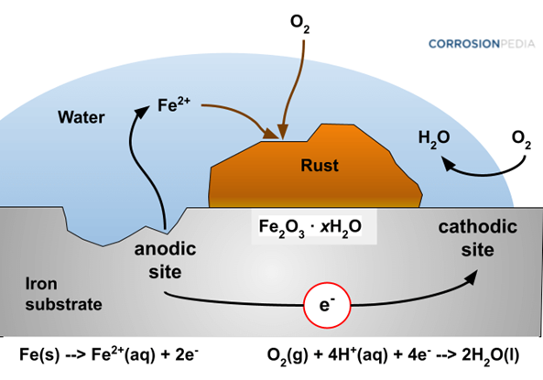
Electrochemical (Single Metal) corrosion or Wet corrosion
Electrochemical corrosion involves redox reactions due to;
Formation of anodic and cathodic areas on the metal surface due to surface imperfections (localized stresses, grain orientation, inclusions in the metal).
Presence of a conducting aqueous medium;
Involves flow of electron-current between the
anodic and cathodic areas.
Oxidation or Anodic Reaction: M → M^{n+} + ne–
(e.g. Fe → Fe²⁺ + 2e– )
Reduction or Cathodic Reactions
Hydrogen : 2H+ + 2e– → H₂ (acidic solutions)
Oxygen: O₂ + 4H⁺ + 4e– → 2H₂O (acidic solutions)
Water: 2H₂O + 2e– → H₂ +OH– (neutral/basic solutions)
Involves flow of electron-current between the anodic and cathodic areas with deposit of corrosion product (rust = FeO(OH), Fe(OH)₃, Fe₂O₃ nH₂O).

Slide 6
Galvanic Cell or Composition Cell Corrosion
Dissimilar metals - When two dissimilar metals (e.g., Zn & Cu) are exposed to an electrolyte, the more negative metal in the electrochemical series (act as anode) undergoes corrosion. The less negative metal act as cathode.
Mechanism: In acidic solution, the corrosion occurs by the hydrogen evolution process; while in neutral or slightly
alkaline solution, oxygen absorption occurs.
The electron-current flows from the anode metal,
(e.g. Zn) to the cathode metal (e.g. Cu).
Common situations: (i) Steel pipe with Cu plumbing
(ii) Steel screws in a brass marine hardware
(iii)Lead-antimony solder around copper wire;
(iv) a steel propeller shaft in bronze bearing.
Multi-phase alloy - Formed by a metal alloy
composed of multiple phases, such as a stainless steel.
The individual phases possess different electrode
potentials, resulting in one phase acting as an anode.
Au = Au⁺⁺⁺ + 3e⁻ | + 1.498
O₂ + 4H⁺ + 4e⁻ = 2H₂O | + 1.229
Pt = Pt⁺⁺ + 2e⁻ | + 1.2
Pd = Pd⁺⁺ + 2e⁻ | + 0.987
Ag = Ag⁺ + e⁻ | + 0.799
2Hg = Hg₂⁺⁺ + 2e⁻ | + 0.788
Fe⁺⁺⁺ + e⁻ = Fe⁺⁺ | + 0.771
O₂ + 2H₂O + 4e⁻ = 4OH ,pH=14 | + 0.401
Cu = Cu⁺⁺ + 2e⁻ | + 0.337
Sn⁺⁺⁺⁺ + 2e⁻ = Sn⁺⁺ | + 0.15
2H⁺ +2e⁻ = H₂ | 0.000
Pb = Pb⁺⁺ + 2e⁻ | - 0.126
Sn = Sn⁺⁺ + 2e⁻ | - 0.136
Ni = Ni⁺⁺ + 2e⁻ | - 0.250
Co = Co⁺⁺ +2e⁻ | - 0.277
Cd = Cd⁺⁺ + 2e⁻ | - 0.403
Fe = Fe⁺⁺ + 2e⁻ | - 0.440
Cr = Cr⁺⁺⁺ + 3e⁻ | - 0.744
Zn = Zn⁺⁺ + 2e⁻ | - 0.763
Al = Al⁺⁺⁺ + 3e⁻ | - 1.662
Mg = Mg⁺⁺ + 2e⁻ | - 2.363
Na = Na⁺ + e⁻ | - 2.714
K = K⁺ + e⁻ | - 2.925

Slide 7
Differential Aeration or Concentration Cell corrosion
It is due to electrochemical attack on the metal surface, exposed to an electrolyte of varying concentrations or with varying aeration.
Oxidation concentration - When one part of the metal is exposed to a different air concentration relative to the another part. This causes a difference in potential between differently aerated areas.
When oxygen has access to a moist metal surface, corrosion is promoted. mostly where the oxygen concentration is the least, less oxygenated becomes anodic and more aerated becomes cathodic.
Sections of a metal that are covered by dirt or scale will often corrode faster, since the flow of oxygen to these sections is restricted.
E.g.: Metal partly immersed in water (water line corrosion) or partially buried in soil.
Electrolyte concentration - A metal bathed in an electrolyte containing its own ions. If a region of the electrolyte, adjacent to the metal, has a decreased concentration of metal ions, this region would become anodic to the other portions of the metal surface and would corrode faster.

Slide 8
Chemical corrosion or Dry corrosion (I)
Oxidation corrosion - Occurs by direct oxidation on metal surfaces in the absence of moisture. Alkali metals (Li, Na, K etc.,) and alkaline earth metals (Mg, Ca, Sn, etc.,) are rapidly oxidized at low temperature. Almost all metals (except Ag, Au and Pt) are oxidized at high temperature.
Mechanism; Oxidation takes place at the surface of the metal forming metal ions
M → M²⁺ + 2e⁻
Oxygen is converted to oxide ion due to the transfer of electrons from metal.
n/2 O₂ + 2ne⁻ → nO²⁻
Overall reaction; oxide ion reacts with the metal ions to form metal oxide film.
2M + n/2 O₂ → 2M^{n+} + nO²⁻
The Nature of the Oxide formed plays an important part in dry oxidation corrosion process. Initially a thin layer of oxide is formed on the metal surface and the nature of this film(Stable or unstable or volatile or porous layer) decides on the further corrosion of the metal.

Slide 9
Chemical corrosion or Dry corrosion (II)
Corrosion by hydrogen - (i) Hydrogen Embrittlement
Loss in ductility of a material in the presence of hydrogen is known as hydrogen embrittlement.
This type of corrosion occurs when a metal is exposed to hydrogen environment. Reacting with H₂S, Iron liberates atomic hydrogen.
Fe + H₂S → FeS + 2H
Hydrogen diffuses into the metal matrix in this atomic form and gets collected in the voids inside the metal. Further, diffusion of atomic hydrogen makes them combine with each other and forms hydrogen gas. Collection of these gases in the voids develops very high pressure, causing cracking or blistering of the metal.
(ii) Decarburisation - when steel is exposed to hydrogen environment at high temperature, atomic hydrogen is formed. Atomic hydrogen reacts with the carbon in the steel and produces methane gas.[C + 4H → CH₄]. The carbon content in steel decreases; decarburization. Collection of methane gas in the voids of steel develops high pressure, which causes cracking.
Corrosion by liquid metal - This is due to chemical action of flowing liquid metal at high temperatures on solid metal or alloy.

Slide 10
Microbiologically Influenced Corrosion (MIC)
MIC involves interaction between microorganisms, such as bacteria, fungi and algae, corrosive media and the metal surface. Some of the common MIC mechanisms are as follows;
Sulphate reducing bacteria (SRBs) reduce sulphates to sulphides which react with metals to produce metal sulphides. Usually detected by the H₂S odour, blackening of waters or the presence of black coloured deposits.
Iron oxidising bacteria require the oxidation of Fe2+ to Fe3+ to produce energy for metabolism. Leading to the formation of Ferric chloride which is extremely corrosive to stainless steel.
Acid producing bacteria (APBs) generate acidic by-products with their metabolism that is corrosive to many materials.
Certain species of Fungi are corrosive, mainly through the production of acids with metabolism.
Heterotrophic slime forming bacteria, the slime they produce cause corrosion.
Methane producing bacteria consume hydrogen promoting depolarisation.

Slide 11
Corrosion under stress
Corrosion occurring under the combined effect of residual/thermal stresses and applied loads in a corrosive medium. Cause sudden premature cracking.
Stress corrosion cracking (SCC) is the brittle cracking of a metal due to the combined effects of localized corrosion and a tensile stress. Very dangerous form of local corrosions. Affects austenitic stainless & high strength steels.
Corrosion fatigue refers to cracking under the combined effect of cyclic stress and corrosive environment.
Hydrogen damage is a corrosion damage resulting from the presence of hydrogen. H2 embrittlement reduce materials ductility & tensile strength.
Erosion corrosion (Physical corrosion) is an accelerated destruction caused by a relative movement between the corrosive medium and the metal surface such as flow of gases, aqueous solutions, organic systems and liquid metal mostly prevalent at elbows and bends in pipes. Types include impingement corrosion (turbulent corrosion), cavitation corrosion, vibration corrosion (fretting corrosion) and friction/erosion corrosion.

Slide 12
Forms of corrosion
Uniform corrosion is characterized by reaction which proceeds uniformly over the entire exposed surface or over a large area. Metal becomes thinner.
Crevice Corrosion is intense localized corrosion frequently occurring within areas such as dips, gasket surfaces, lap joints, and crevices under bolt and rivet heads on metal surfaces.
Pitting corrosion is a form of extremely localized attack that results in holes in the metal. Very destructive and insidious forms of corrosion causing failure due to a very small % loss of the entire structure.
Intergranular corrosion is localized attack at and adjacent to grain boundaries, with relatively little corrosion of the grains. The grains fall out and lose its strength. Depletion of chromium in the grain-boundary regions results in intergranular corrosion of stainless steels.
Selective leaching is the removal of one element from a solid alloy by corrosion. Occur in alloy systems in which Al, Fe, Co, Cr, are removed.

Slide 13
Corrosion thermodynamics
Corrosion reactions inevitably involve electron transfer. Thermodynamics can provide a basis for the understanding of the energy changes associated with the corrosion reaction.
It can predict when corrosion is possible. Thermodynamics cannot predict corrosion rates. The rate is governed by kinetics.
The Gibb’s free energy equation provides us with a tool with which to predict if a corrosion reaction is thermodynamically possible: ∆G = -nFE
where ∆G = Gibb's free energy (Joules)
n = electrons transferred in oxidation reaction (mol e⁻)
F = Faraday's constant (96,500 J/v - mol e⁻)
E = Standard emf potential = E_{ox} + E_{red} (volts)
E_{red} = Standard potential for cathode half cell (volts)
E_{ox} = Standard potential for anode half cell (volts)
If ∆G is +ve, reaction will not proceed. If ∆G is -ve, the reaction is possible.

Slide 14
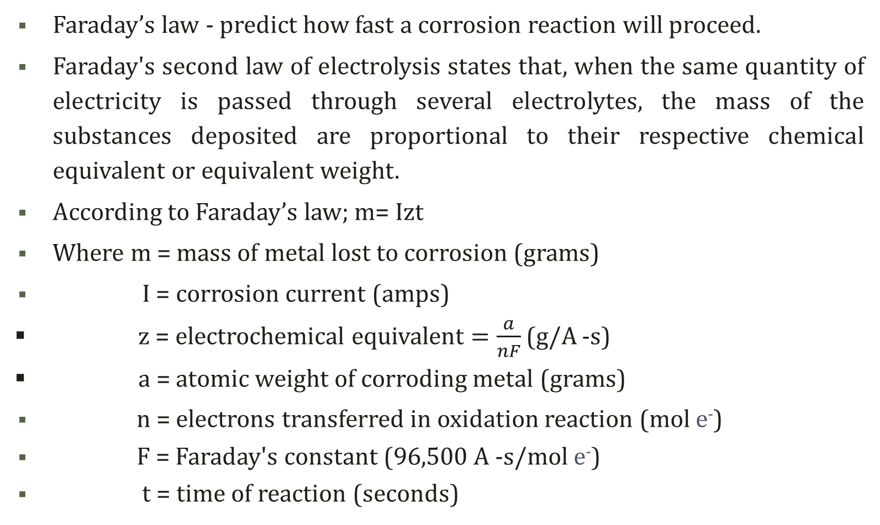
Electrochemical kinetics of corrosion

Slide 15
The Rate of metallic corrosion
The rate of corrosion can be determined by the potential difference between the anode and the cathode and the resistance of the corrosion cell.
The corrosion current, I =V/R
The greater the resistance the lower the corrosion current and from Faraday’s law the lower the mass of metal loss.
Thus, a high resistance within the corrosion cell is beneficial for control. This resistance may result from one or more of the following factors:
Resistance of the electrical connection between anode and cathode.
Resistance of the electrolyte.
High concentration of anode metal ions in solution.
Reactant build-up at the cathode.
Lack of reactants at the cathode.

Slide 16
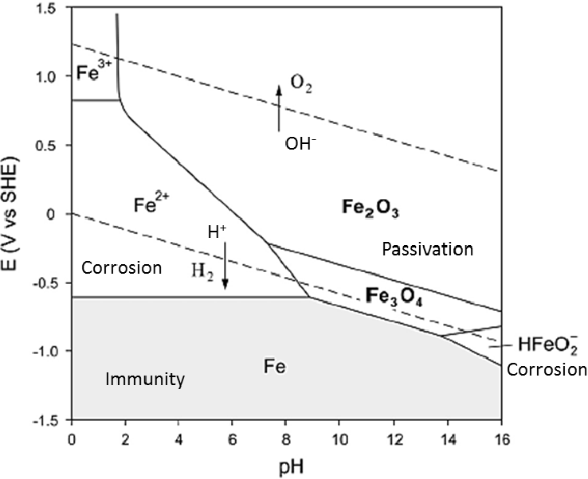
Pourbaix Diagram
Pourbaix Diagram for Fe-H₂O at 25 °C
A Pourbaix diagram provides information about the stability of a metal as a function of pH and potential. It gives a guide to the stability of a particular metal in a specific environment.
Immunity – region of thermodynamic stability of the pure metal. Corrosion is thermodynamically impossible; Passivity - region of thermodynamic stability of the metal oxide. Corrosion is mitigated by the formation of a “passive” protective oxide; Corrosion shows that general attack will occur.

Slide 17
Factors which Influence Corrosion
The nature and extent of corrosion depend on the metal (inhomogeneities in metal surfaces, reactivity of the metal) and the environment. The important factors which may influence the corrosion process are:
Nature of the metal, nature of the environment (presence of gases; O₂, H₂ &
SO₂ including dissolved gases O₂, CO₂, & H₂S) & chloride ions &
Conductivity; The amount of metal that dissolves is directly proportional to the amount of current flow between anode and cathode. For iron, one amp of current flowing for one year will result in the loss of 9.1 kg of metal.
Temperature (corrosion proceeds faster in warmer environments) .
Electrode potential, Aeration (including differential) & Agitation.
pH: In general, lower the pH, the higher the rate of corrosion. If the pH is greater than 10, corrosion of the metal is very slow. If pH is between 3 and 10, then the presence of oxygen is essential for corrosion of iron. If the pH is ≤ 3 severe corrosion occurs in the absence of air due to the continuous evolution of H₂ at the cathode. [However, this is not always the case, some metals like Al, Zn etc., undergo fast corrosion in highly alkaline medium.]

Slide 18
Atmospheric corrosivity categories and examples of typical environments

Slide 19
Corrosion control – Isolation Methods
The isolation control method consist of forming a layer of protective layer on the metal surface to avoid contact with the corrosive environment;
Metallic coating methods include electroplating or hot-dip plating, thermal spraying, diffusion coating, and ion plating. Metal coatings such as zinc plating, tin plating, nickel plating, chromium plating, and aluminium plating are widely used. Thickness of coatings are relatively thin, only a few microns to dozens of microns.
Non-metallic coating - 2 types; inorganic coating and organic coating. The 1st type consist of enamel coating, glass coating, ceramic coating, and Portland cement coating. Organic coatings includes paint coating, rubber coating, plastic coating, and antirust oil coating.
Reactive coating - these chemicals form an electrically insulating or chemically impermeable coating on exposed metal surfaces, to suppress electrochemical reactions. Chromate film, phosphate film, oxide film of iron, and aluminium anodic oxide film are currently used. It is necessary to have a sealing treatment by immersing in oil or waxing.

Slide 20
Corrosion control – Thermodynamic Methods
Modifying the electrode potential of the metal in the corrosive environment can prevent or slow down the corrosion of the metal. Pourbaix diagram - shifting from the corrosion zone to the immunity area or a passivation area.
Cathodic protection - making the metal surface the cathode of an electrochemical cell, 2 methods; (i) Sacrificial anode protection involve the connection of galvanic anodes (more -ve potential) to the protected metal. The anode material corrodes and eventually it must be replaced. (ii) Impressed current (IC) method use anodes connected to a DC power source. Anodes for IC systems are tubular and solid rod shapes of various specialized materials.
Anodic protection involves applying anodic current to the metal by an external power source in order to shift potential to the passive region.
Passivation makes use of mild oxidants such as nitric and citric acid. These acids get rid of exogenous free iron, sulphides and other foreign particles from the surface and create an oxide film which acts as a protective shield. It is critical that such treatment with acid should not considerably affect the metal itself. It significantly reduces the risk of future corrosion due to air.

Slide 21
Corrosion control – Kinetics Methods
By controlling the reaction kinetics we can prevent or slow down the rate of metal corrosion. control method
Material selection is the key parameter for controlling corrosion. Most steels fall into one of the following groups: carbon steels, low-alloy steels, high-alloy steels, tool steels, and stainless steels. Stainless steels are typically used for their corrosion resistance properties. They generate a corrosion resistance film (Cr₂O₃) on the metal surface, which can retard the anodic dissolution reaction of iron efficiently.
Corrosion inhibitor is a general term for inorganic or organic substances with the ability of retarding the electrode reaction in the corrosion cell. Inhibitor is adsorbed on the surface and forms a protective film in the corrosive medium. Corrosion inhibitors can be divided into anodic inhibitor, cathodic inhibitor, and mixed inhibitor.
Treating the environment (water treatment, dehumidification). Removing the harmful substances, such as chlorine ions, dissolved oxygen, and
sulphur, and adjusting the pH. (dehydration, deoxidation, and desalination)

Slide 22
Corrosion Control by Improving Design
Avoid Galvanic Corrosion Cells - by using similar metal throughout the structure or by avoiding electrical contact by insulating different materials.
Avoid moisture and debris traps– that would accelerate corrosion, and could lead to pitting corrosion by formation of differential aeration cells.
Avoid crevices - seals should be used and pressure should be adjusted on the gaskets to prevent liquid penetration inside crevices, so as to avoid stagnant water in crevices and narrow gaps.
Drainage and ventilation, provision should be made to enable the steel to dry out, minimise the ‘time of wetness’, provision of drainage holes where necessary, and the provision of free circulation of air around the structure.
Stress concentrations in components exposed to corrosive mediums should be avoided, especially when using materials susceptible to stress-corrosion cracking. Use uniform & simple geometry, Access for coating application and maintenance
Access to all surfaces, narrow gaps, difficult to reach corners, and hidden surfaces should be avoided. Allow access for coating and inspection.

Slide 23
Corrosion control of steel in concrete
Concrete is a porous material as a result of cement hydration and the pore structure dependent on several factors such as the w/c ratio or curing temperature. Three main types of pores are identified: gel pores (ranging from 1 to 10 nm); capillary pores (ranging from 10 nm to 10 µm) and macro pores and air voids (from 10 µm up to several mm).
Passive oxide film removal resulting from pH decrease is due to the ingress of harmful ions like carbon dioxide, sulphur dioxide, chloride, etc.
Proper design and workmanship that ensure adequate concrete cover, proper concrete quality, and correct installation of reinforcement can reduce the risk of corrosion.
Corrosion inhibitors can be added to the concrete to reduce the rate of corrosion.
Cathodic protection involves applying a small electric current to the reinforcement, which reduces the rate of corrosion.
SCM and admixtures - increase compactness and reduce permeability.
Controlled permeable formwork (CPF) liner – maintain cover quality.

Slide 24
THANK YOU

