Slide 1
Strategic Marketing
Introduction to Strategic Marketing Management
Unit 1

Slide 2

Unit 1- Introduction to Marketing

Slide 3
Definitions – Strategic Marketing
… is the process of aligning the marketing activities of an organization in such a way that they help organizations meet their strategic objectives (Klein, 2007)
… consists of putting together a plan for the best use of the resources of organization and improving tactics to meet its corporate objectives.
… is the process that helps organizations reach their long term objectives.

Slide 4
The Marketing Plan
Where are we now? Current Situation
Where do we want to be? Goals / Objectives
How can we get there? Strategic Choices
Which way is best? Strategy Direction
How we ensure arrival? Monitoring & Control
Have we arrived? Objective achieved and feedback

Slide 5
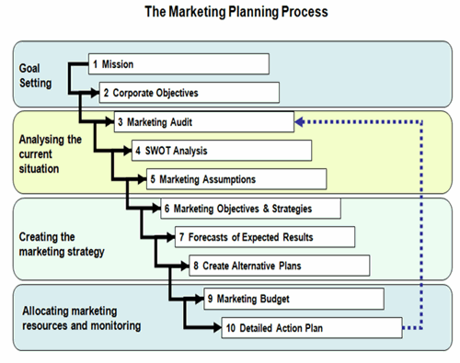

Slide 6
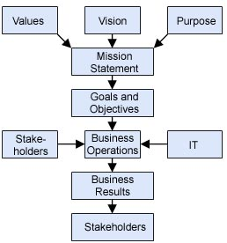

Slide 7
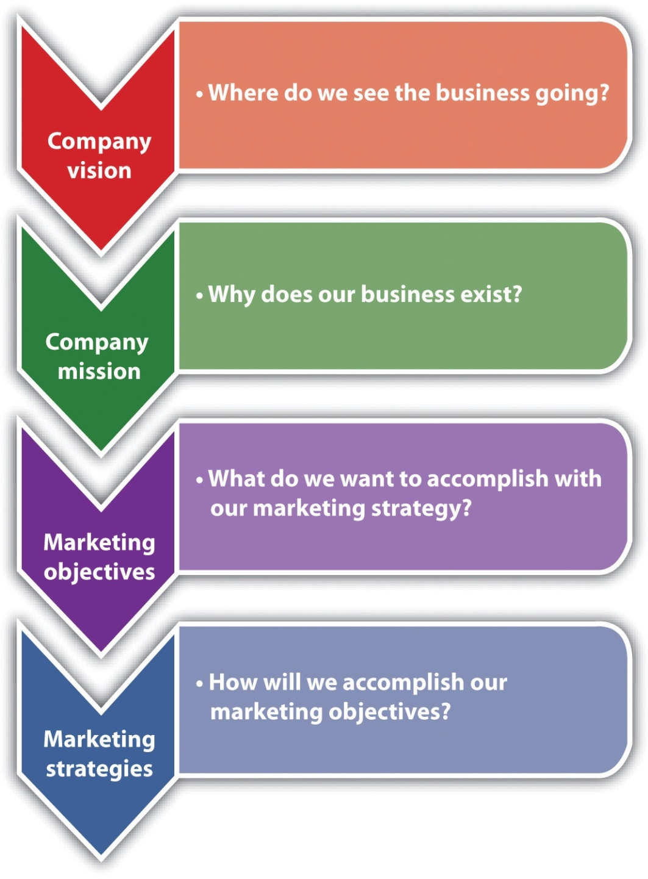
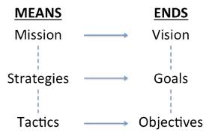

Slide 8
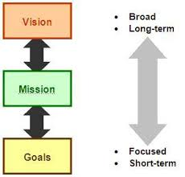
Summary
Strategy is about:
  What? and Why? of marketing activities
Implementation is about:
  Who? Where? When? and How?

Slide 9
Strategic Marketing
Contemporary Marketing Philosophies
Unit II

Slide 10
Contemporary Marketing Philosophies
Societal and Ethical Issues in Marketing – Growing Evidence of the 8th “P”
  Business Ethics
  Environmental Issues
  Personal Ethics
  Health and Safety

Slide 11
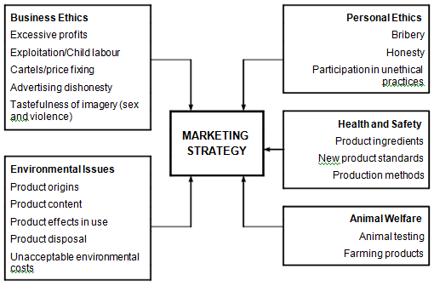

Slide 12
Commercial and Societal Marketing
      The purpose of commercial marketing is to increase sales and revenue.
      The purpose of social marketing is societal benefit rather than commercial profit.
      Its purpose is to bring about positive health and social change.
      Its ultimate outcome is behavioural change rather than increased sales.

Slide 13
Traditional Business Orientation Concepts
Production
Product
Selling
Marketing
  Customer Orientation
  Organisational Integration
  Mutually Profitable Exchange
Customer
Profit

Slide 14
Emerging Marketing Philosophies
Societal / Green Marketing
  The impact of organization's marketing activities on society.
Relationship Marketing
  the process of establishing long-term stable mutually beneficial relationships with stakeholders.
Internal Marketing
  Developing a marketing plan internally
E-Marketing
  Marketing in the virtual environment
Real “Customers” Approach
  Who are the Customers, Users , Purchasers?

Slide 15
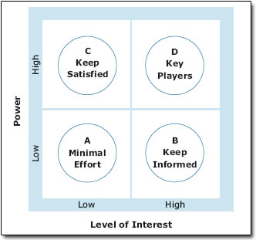
Power and Interest Matrix

Slide 16
EVA and Value Based Marketing
EVA - the value generated to shareholders / owners
VBM - it is "by delivering superior value to customers that management can, in turn, deliver superior value to shareholders" (Doyle).
Delivering VBM
  Develop a deep understanding of customer needs, operating procedures and decision-making processes.
  Formulate value propositions that create differentiated advantage.
  Build long-term relationships with customers
  The delivery of superior value to customers requires superior knowledge, skills, systems and marketing assets.

Slide 17
CSR
It refers to an organisation’s obligation to maximise its positive impact and minimise its negative impact on society.
Against CSR - that CSR is a distraction from management’s responsibility to add value to shareholders, and if organisations focus solely on their business objectives, they will maximise benefits to society through increased taxes, employment, etc.
In Support of CSR - that organisations have responsibilities to be good “corporate citizens” and should seek to improve society and safeguard the environment.

Slide 18
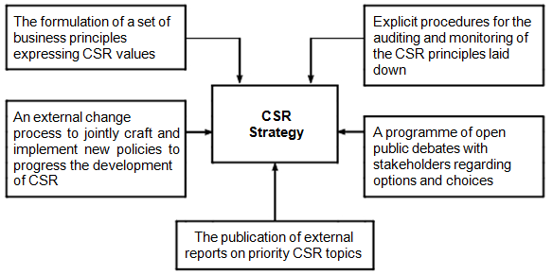
Developing a CSR Strategy

Slide 19
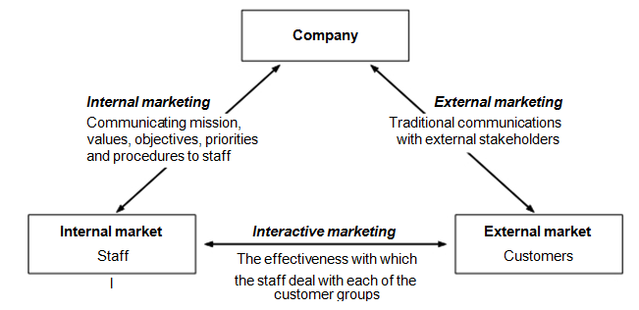
Internal Marketing Philosophies

Slide 20
Internal Marketing Philosophies
Six Steps that should be considered:
      the creation of internal awareness
      identification of internal “customers” and “suppliers”
      determination of internal customer’ expectations
      communication of these expectations to internal suppliers
      internal suppliers’ modifications to their activities to reflect internal customer views
      a measure of internal service quality and feedback to ensure a satisfactory exchange between internal customers and suppliers

